Slide 1
Don’t Judge a Book by It’s Cover: Unlock the Value of Every Donor

Slide 2
America’s biggest donors gave $16 billion in 2022.
Source: The Chronicle of Philanthropy, February 2023

Slide 3
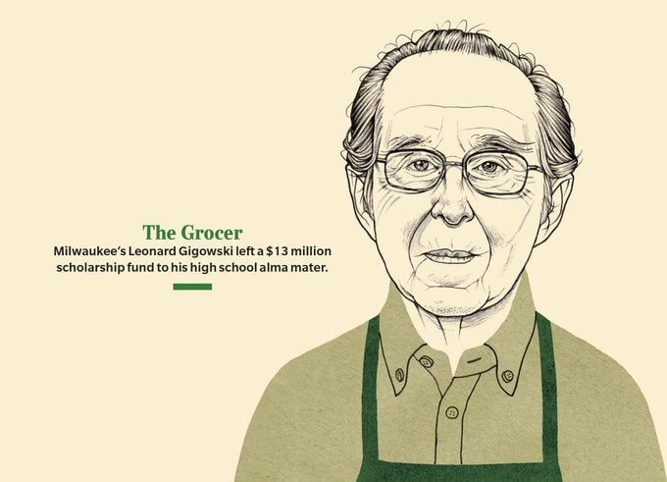
Source: Reader’s Digest
Source: Reader’s Digest

Slide 4
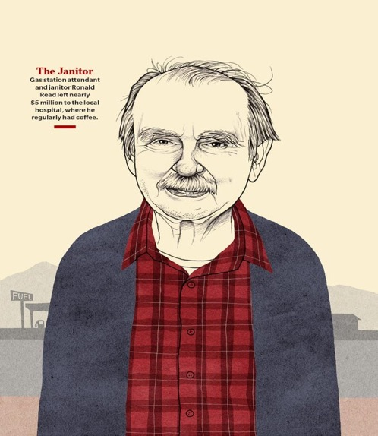
Source: Reader’s Digest
Source: Reader’s Digest

Slide 5
How to Notice Them
Stewardship activities
Routine research
Wealth screening
Notes:
Too often judge donors/prospects by appearance. How can we notice the major gift prospects already within our world

Slide 6
Philanthropic Motivations (PM)
Belief in mission
Believe gift can make a difference
Personal satisfaction, enjoyment, or fulfillment
Give back to your community
Tax benefit
Source: The 2021 Bank of America Study of Philanthropy: Charitable Giving by Affluent Households

Slide 7
Philanthropic Motivations (PM)
Remedy issues
Support social justice aims
Spontaneous response to a need
When you are asked
Source: The 2021 Bank of America Study of Philanthropy: Charitable Giving by Affluent Households

Slide 8
How affluent donors choose a cause or organization to support (PC)
My values (71.5%)
Interest in issue (57.2%)
Recognizable, reputable non-profit (55.4%)
First hand experience (52.1%)
Source: The 2021 Bank of America Study of Philanthropy: Charitable Giving by Affluent Households

Slide 9
How affluent donors choose a cause or organization to support (PC)
Perceived need (48.0%)
Association with another institution (24.5%)
Non-profit ranking reports (20.3%)
Source: The 2021 Bank of America Study of Philanthropy: Charitable Giving by Affluent Households

Slide 10
How affluent donors choose a cause or organization to support (PC)
Compelling pitch (13.1%)
Social circle endorsement, pressure (10.9%)
Affinity group discussions (2.5%)
Source: The 2021 Bank of America Study of Philanthropy: Charitable Giving by Affluent Households

Slide 11
Don’t Make a Mistake… A Big Mistake!

Slide 12
He died a year ago. His estate just gave Tampa Bay charities $63 million.
“A few nonprofits say the gifts from St. Petersburg’s “secret millionaire” David Baldwin are their largest ever.” Jay Cridlin, Times staff Published April 6, 2022

Slide 13
Timeline of a transformational gift
First Gift $5K
Declined Tour
Lunch with Leadership $100K Gift
Continued Transformational Gifts, Touching All Programs
Early 2013
Late 2013
2022
2012
Late 2013
2014-2021
Attended Event Toured Facility Funded Staff Position
$1.5M Capital Campaign Pledge
Posthumously Named to Philanthropy 50 List

Slide 14
September 2012
Donor made first time gift of $5,000
Immediately called to thank, asked about motivations
Liked efficiency of organization
Declined invitation for tour
Belief in mission
Tax benefit
Non-profit ranking reports
Interested in the issue
Recognizable/reputable non-profit

Slide 15
January 2013
Donor attended Donor Appreciation Event
Expressed interest in taking tour
Perceived need
Compelling pitch

Slide 16
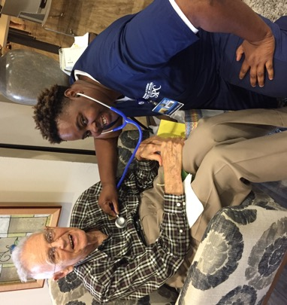
February 2013
Donor toured food pantry and health center
Belief in mission
Tax benefit
Interest in the issue area
First hand experience
Notes:
Investigative questions were asked. Give examples

Slide 17
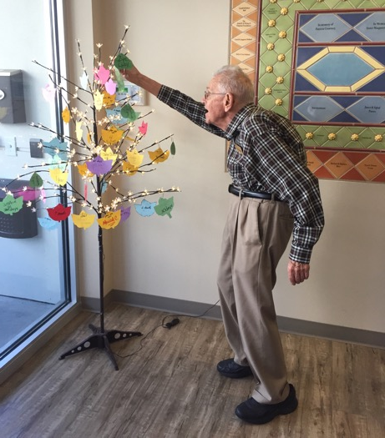
Engage Donors
Your turn!
With 2 other people, think of 3 unique ways to engage a donor while asking meaningful questions.
Notes:
Sara leads breakout

Slide 18
February 2013
Made commitment to support ARNP position
Personal satisfaction, enjoyment or fulfillment
Spontaneous response to need
Interest in the issue
Compelling pitch
Notes:
Monthly stewardship began - sent report of outcomes of ARNP plus a story

Slide 19
August 2013
Lunch at Women’s Residence with executive director, Health Center Director, Director of Women’s Residence
Belief in the mission
Believe gift can make a difference
Personal satisfaction, enjoyment or fulfillment
Give back to your community
Notes:
Here he heard personal stories from the Health Center. The location was strategic since we were beginning to embark on a capital campaign to build a larger women’s residence.

Slide 20
December 2013
Donor informed of another need in Health Center
Provided $100K to fund need
Belief in the mission
Believe gift can make a difference
Personal satisfaction, enjoyment or fulfillment
Give back to your community
Tax benefit
Remedy issues
Support social justice aims
Spontaneous response to a need
When you are asked
Notes:
Lunch was arranged at the Women’s Residence with ARNP, Executive Director, and Director of Women’s Residence.
On the walk back to donor’s car, he mentioned that he would like to learn more about Capital Campaign for new Women’s Residence.

Slide 21
December 2013
Received $1.5M pledge to kick off Capital Campaign
Belief in the mission
Believe gift can make a difference
Personal satisfaction, enjoyment or fulfillment
Give back to your community
Tax benefit
Support social justice aims
Spontaneous response to a need
When you are asked
Recognizable/reputable non-profit
Compelling pitch

Slide 22
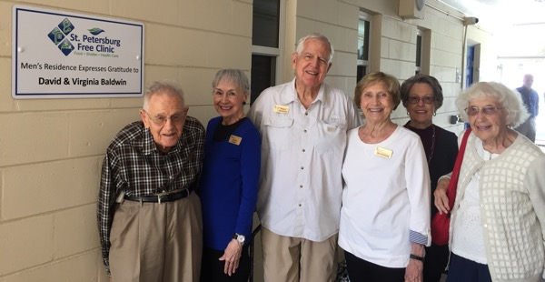
2014 - 2021
Continued to make transformational gifts to make dreams come true in every program of the organization
Shared we were 1 of 4 charities in his will, but would not disclose details or share a copy

Slide 23
Planned Gift
Focus on values
Cast a vision for something bigger
Present the opportunity
Notes:
Referred David to Community Foundation
2017 - Hurricane Irma. Asked for a $12 million planned gift for Women’s Residence Endowment

Slide 24
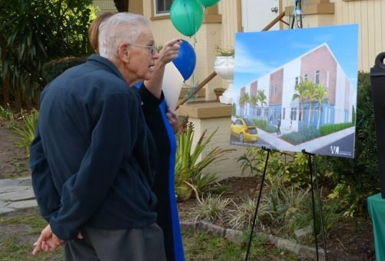
He provided over $11M to our organization while alive and $9.5M upon his death.

Slide 25
But…
5 other charities in Tampa Bay received a total of $63M upon his death and they were all surprised
One mentioned that he was giving $17,000/year
What would have happened if they hadn’t judged a book by it’s cover?

Slide 26
Meaningful Conversations
Using your engagement ideas, when you are with the donor:
What information would be helpful to glean from the donor?

Slide 27
Notes:
Do not modify the notes in this section to avoid tampering with the Poll Everywhere activity. More info at polleverywhere.com/support What information would be helpful to glean from the donor?
https://www.polleverywhere.com/free_text_polls/XxEx4hTeQRAgcGCiEexDt

Slide 28
Engagement Defined
Ways donors interact with the nonprofit and strategies the organization uses to create stronger ties with its supporters. Donor engagement leads to donor retention.

Slide 29
Ethics of Donor Relationships
Relationship with the organization
Research parameters

Slide 30
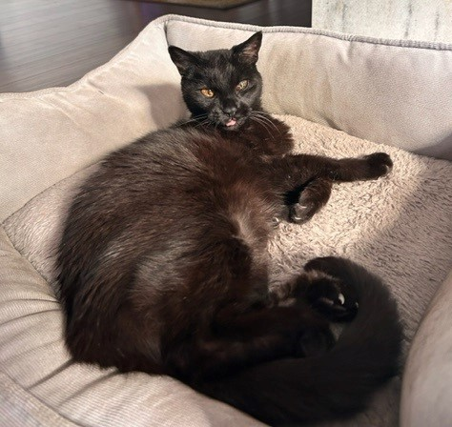

Slide 31
Contacting Us
Debbie Sokolov, CFRE, MNA debbie.sokolov@thejamesmuseum.org (727) 892-4200 | Sara Leonard, MBA, CFRE sara@SaraLeonardGroup.com (863) 310-2364

