Slide 9
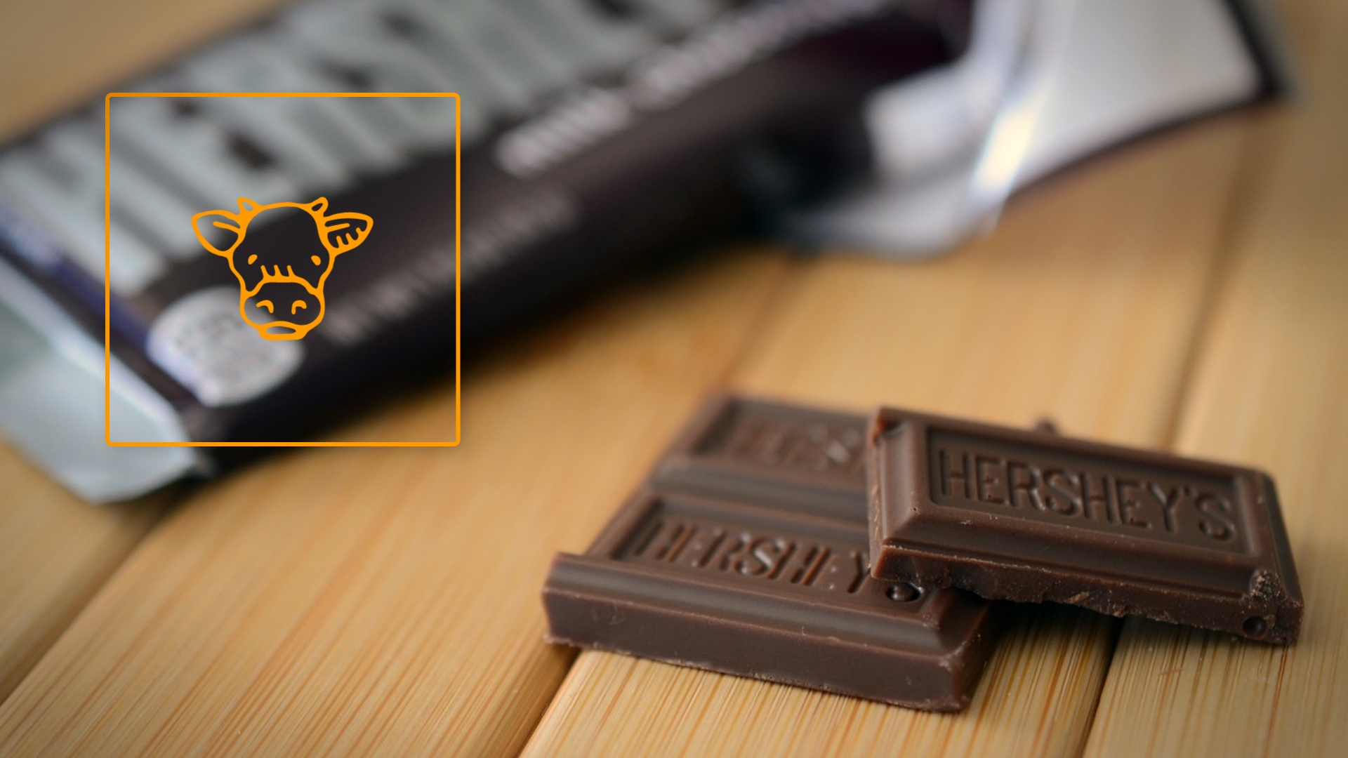

Slide 12
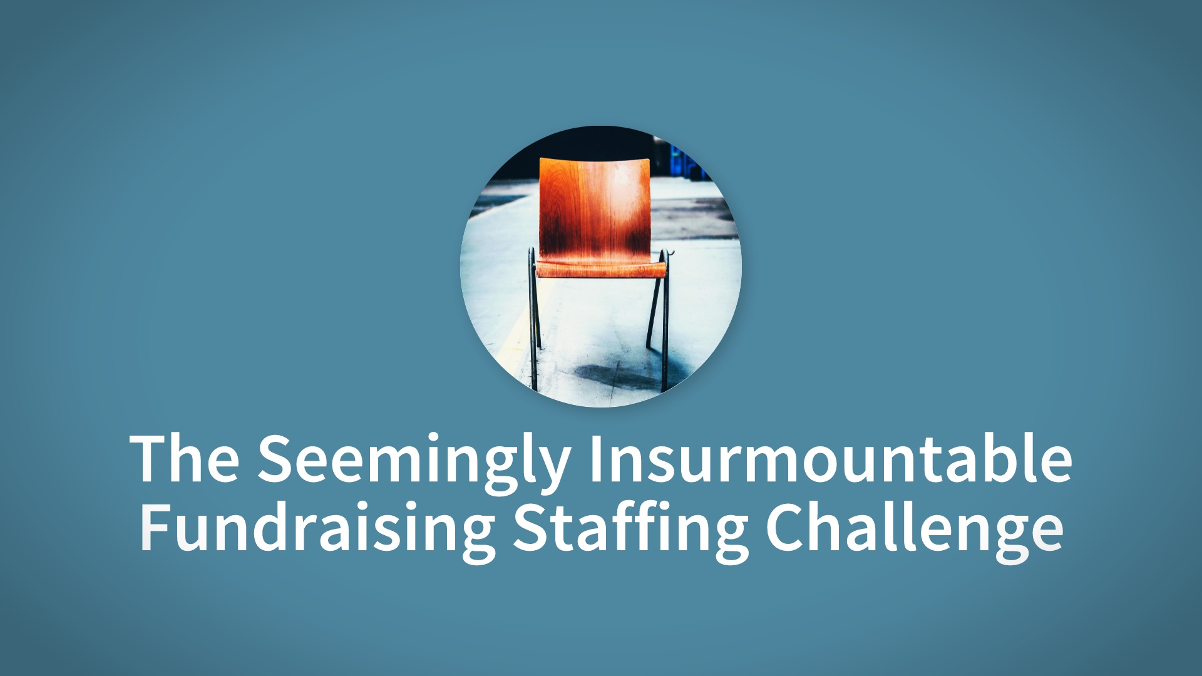

Slide 20
Notes:
Video URL: https://player.vimeo.com/external/174002812.hd.mp4?s=adbd4371ef546a2a57027fb7e799649cb0af2bd8&oauth2_token_id=57447761

Slide 21
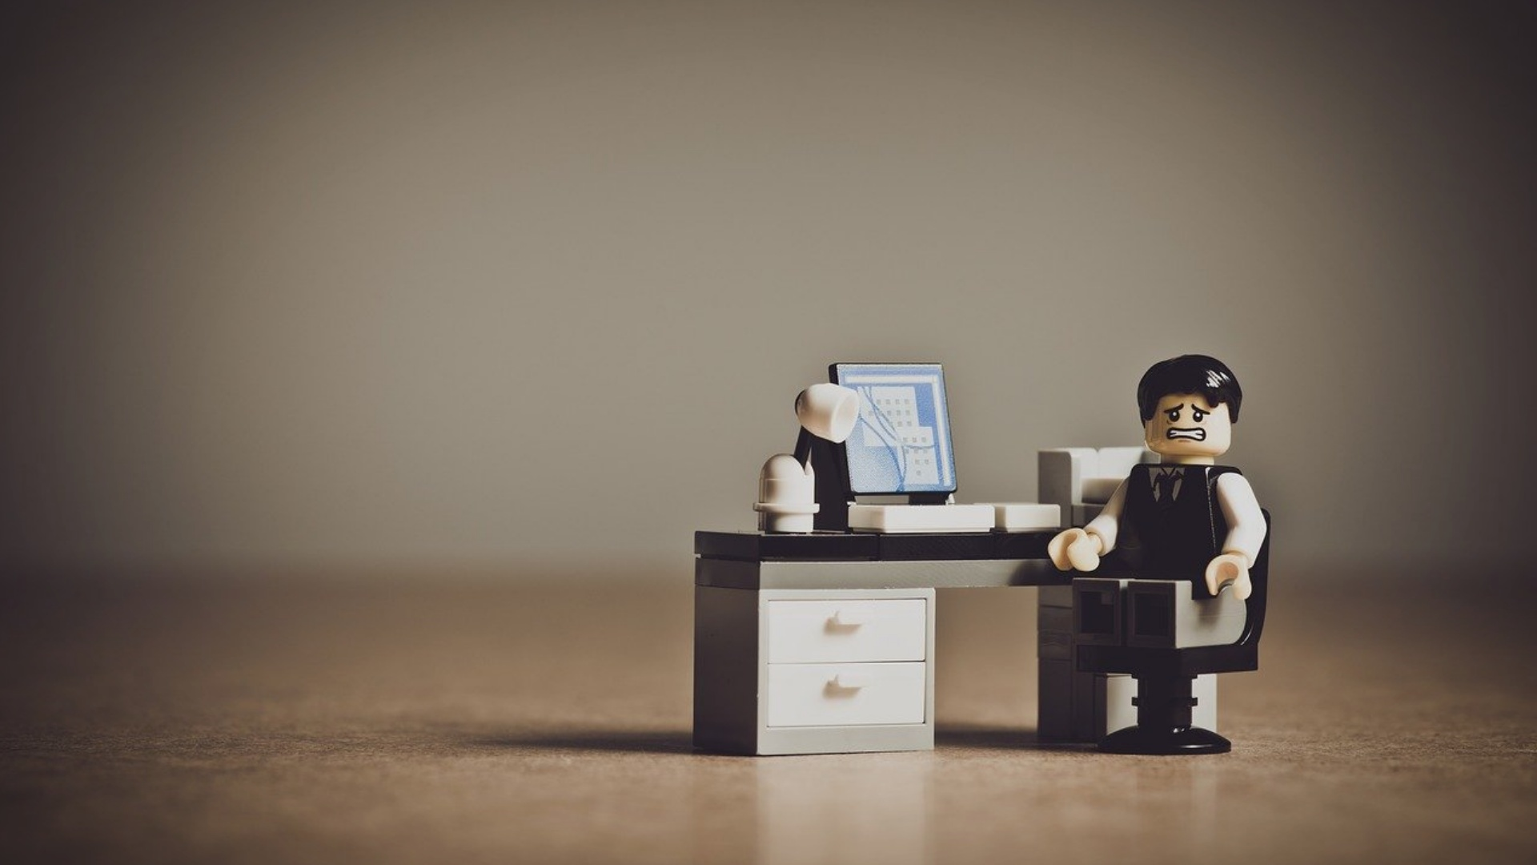

Slide 35
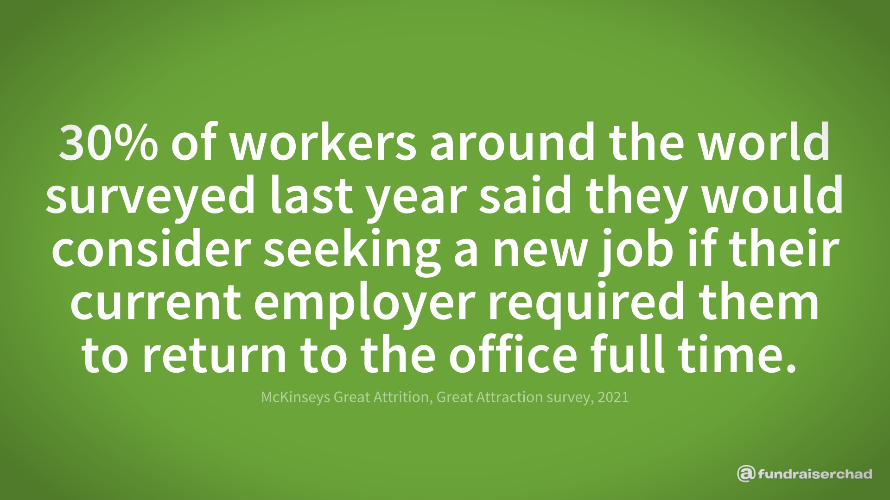

Slide 39
Notes:
Video URL: https://player.vimeo.com/external/364032909.hd.mp4?s=2ce444439afd82c5c36d9c83b3975e666b255cdd&oauth2_token_id=57447761

Slide 42
Notes:
Video URL: https://player.vimeo.com/external/555571017.hd.mp4?s=b30e803611337921fbf2cb7e8d3431931c43e4d7&oauth2_token_id=57447761

Slide 44
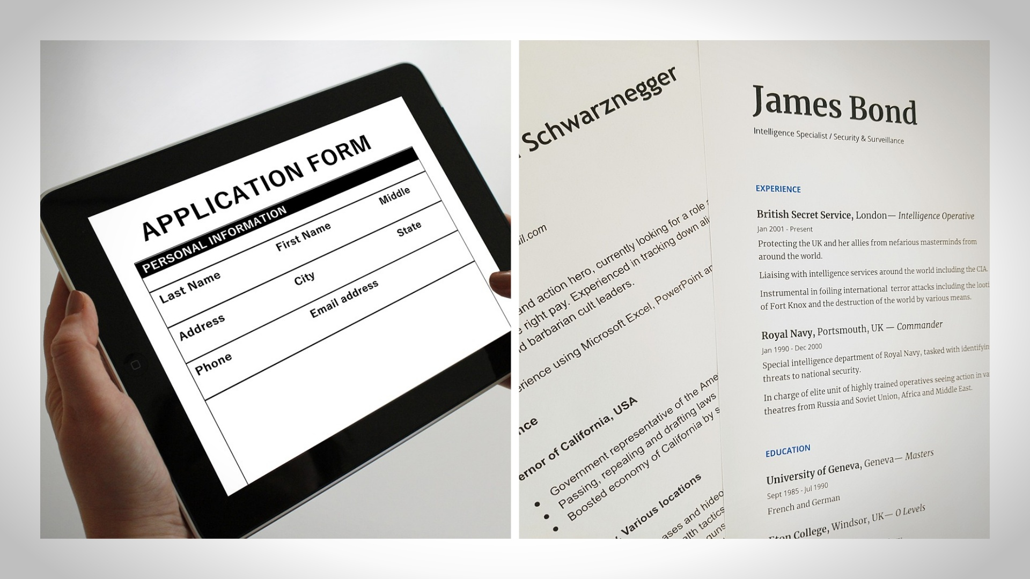

Slide 45
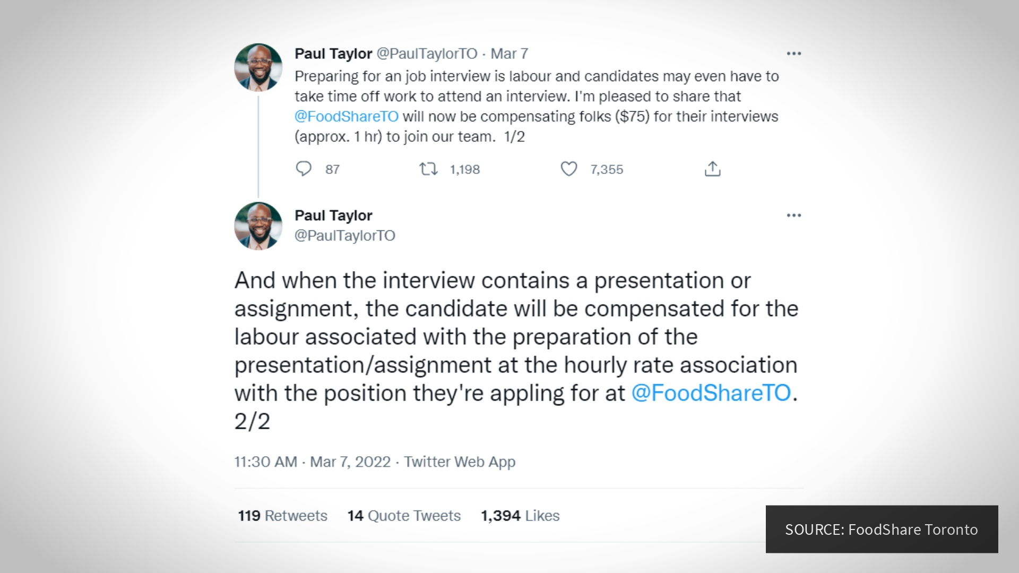

Slide 53
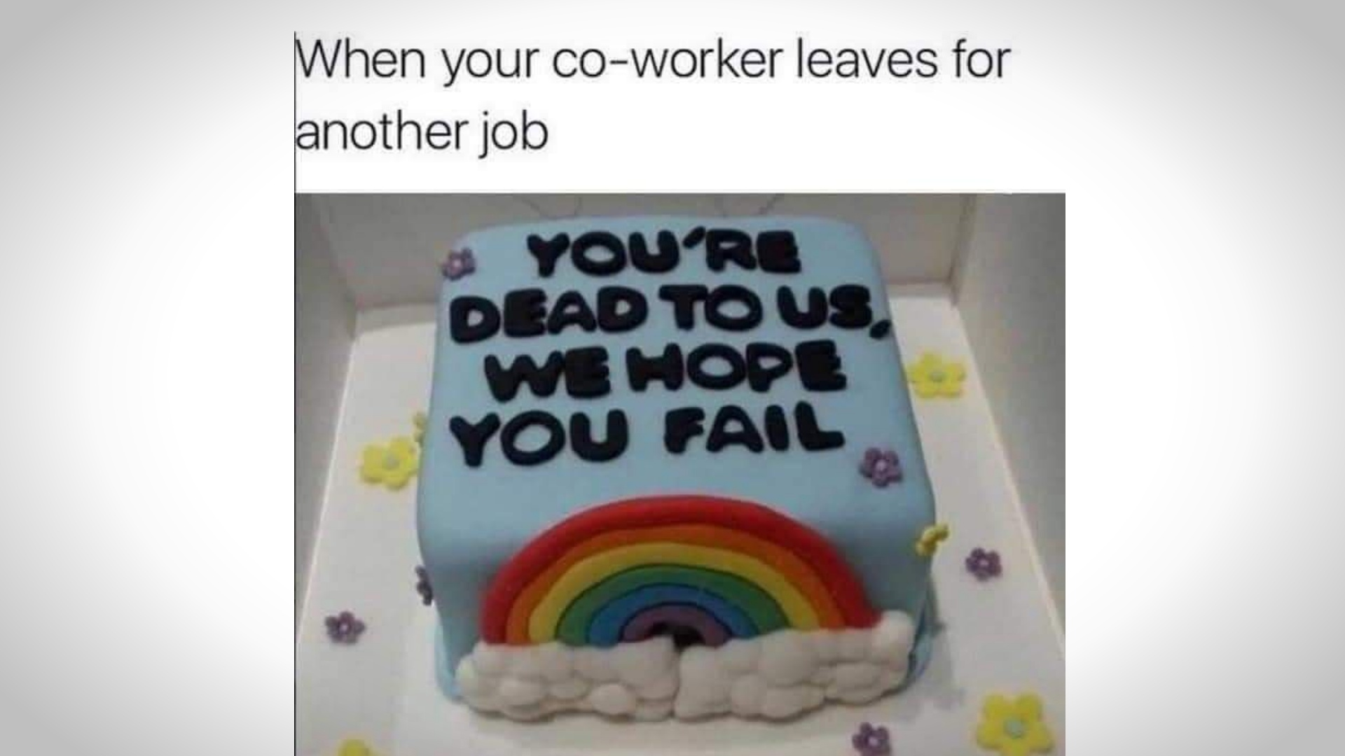

Slide 54
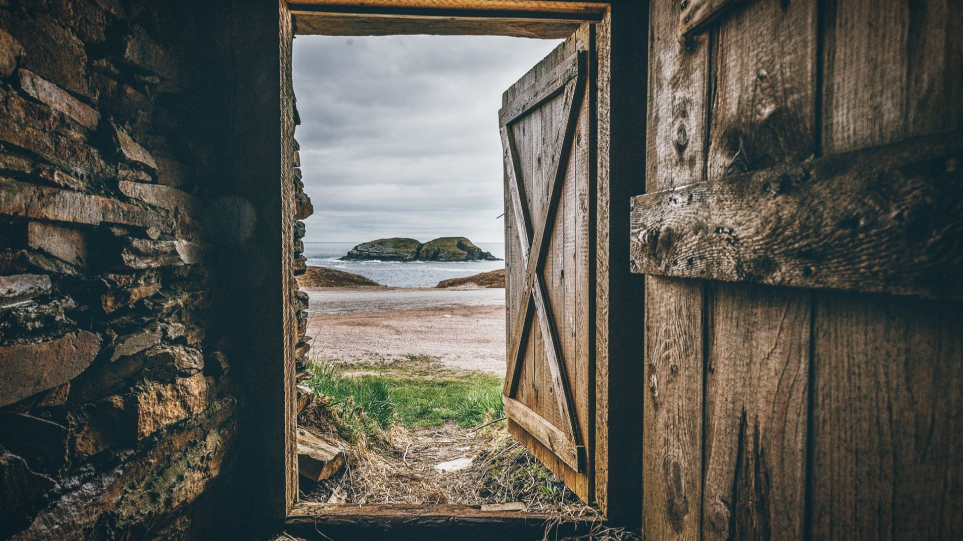

Slide 55
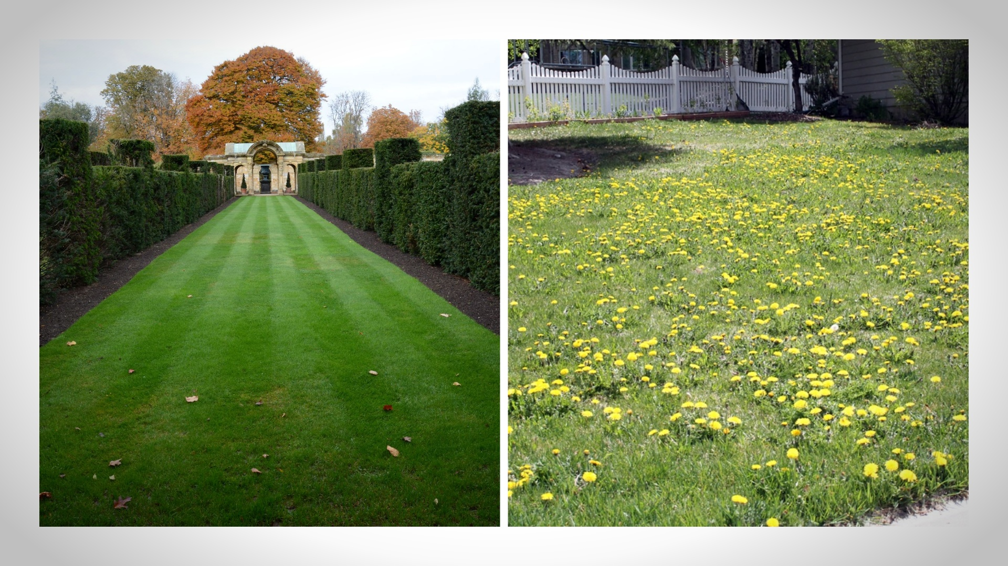

Slide 56
Notes:
Video URL: https://player.vimeo.com/external/513367951.hd.mp4?s=be12dc84fe1d80c90894a7ab7fe427257384ef95&oauth2_token_id=57447761

Slide 58
Notes:
Begin with small talk (weather, sports, hobbies, grandchildren, etc. – can be 50%+ of meeting) / create connection & likeability

