Slide 1
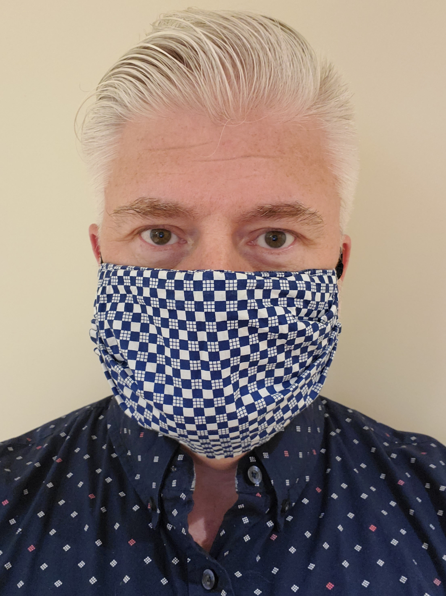
OBSTACLE SCHMOBSTACLE!
How to go over, under, around, and through to get your YES
B. Michael McFarland
Chief Development Officer
HomeFirst

Slide 4
What is Acting?
Simplified Stanislavski (father of modern acting)
An actor has a superobjective with sub-ojectives along the way.
To achieve each objective, an actor overcomes obstacles.
Is Fundraising any different?

Slide 5
Why are you here?
It’s Sunday
It’s 4pm
You’re in New Orleans
What do you want to get out of this?

Slide 6
What is your Super-Objective?
Notes:
Help more people
Provide the Arts
Save the planet
Cure cancer
End homelessness
Others

Slide 7
What are Fundraising Sub-Objectives?
Notes:
Inform the donor about…
Get a coffee, tour a site, meet with the CEO, come to the Gala
The Ask Meeting
Sub-objectives are all about Cultivation and Stewardship
Obstacles can occur throughout the processes

Slide 8
NŌbstacles
Notes:
There are HARD no’s:
Job loss
Death
Bankruptcy
Crime

Slide 9
Obstacles

Slide 10
Obstacles can be OVERCOME
Notes:
Simplied Boleslavsky
Process to overcome obstacles to your objective
Focus
Listen
Think
React
With memory and concentration

Slide 11
Who are the masters at overcoming obstacles?
Notes:
CHILDREN!
Ask any parent
Children know the secret
Which parent to ask for what, and exactly what day, what time, to ask
How many “nos” it takes to get to “yes”
Change the “need”, make it STRONGER

Slide 12
Know the Biggest Secret of All
Notes:
WORDS
ARE
JUST
PROPS
TO
ACHIEVE
YOUR
OBJECTIVE

Slide 13
IT’S GAMETIME!

Slide 14
Game 1: FOCUS
Notes:
Red Light/Green Light
Notice how energy changes as things get closer
Be aware of your energy and others and do you change yours to match theirs?
Passion is infectious and donors will be attracted to your passion
At home exercise: tug-of-war and crunches belly
Also teaches you to ‘listen’ to NONVERBAL CLUES

Slide 15
Game 2: LISTEN
Notes:
Brain research: we can’t really multi-task
Exercise volunteers: cannot know one another
1: take out your device and start posting about this session or checking your next or making dinner reservations
2: tell Volunteer 1 your organization’s mission, vision, and the most rewarding accomplishment of yours over the past few months
Volunteer 1: what’s V2’s mission, vision, and accomplishment?
Now repeat without device and tell us

Slide 16
Game 3: THINK
Notes:
Crowd give a topic to discuss
Volunteer 1 must get Volunteer 2 to say the name of their organization without asking for that

Slide 17
Game 4: REACT
Notes:
Volunteer 1: sit in a chair, your objective is to stay in that chair
Volunteer 2: you need that chair empty
REFRESH: WHAT IS ACTING?
We learned to focus, listen, think, and react, now what about reacting with memory and concentration?

Slide 18
Game 5: CONCENTRATE
Notes:
Groups of 3 volunteers
Volunteer 1, tell volunteer 2 about your org’s mission, vision, target population, and one story of success
Volunteer 2, don’t listen focus on him/her/they
Volunteer 1 step to the side, Volunteer 3 looks at 1
Volunteer 2, describe what they’re wearing; how detailed can you be?

Slide 19
Game 6: MEMORY
Notes:
Hot Potato Mission
Round 2: Hot Potato Vision
Round 3: One great statistic from your org, then another, then another

Slide 20
Words are Props to Achieve Objective
Notes:
Mission & Vision
Statistics
Client/Services Stories
Case for Support
Need Statement
Research on Donor

Slide 21
Game 7: FIRE IN THE BELLY
Notes:
9 Volunteers line up in groups of 3
Why should Mrs. Bezos give to you? 2nd Round? 3rd Round?
Audience vote on 1 per group
3 finalists, same thing
Round 1? Round 2? Round 3?
Audience vote on 1

Slide 22
Obstacle Schmobstacle
An overcomeable obstacle is an opportunity
Notes:
Focus on the donor’s needs: why do they want to give to you? Where does their passion marry your org’s?
Listen to the donor: they’ll tell you their passion, what they like, what they don’t.
Think: what will help you get past obstacle 1? A statistic? A client story? Likemindedness? Head? Heart?
React with Memory and Concentration: Use the props you have
Never be afraid to change your objective (see next slide)

Slide 23
Change Objective to Achieve Objective
Notes:
I had a major ask, to that point, biggest in my career.
I got a hard NO.
Objective changed: get a follow up meeting
“I’d like to go back and get some answers to your concerns. When I do, I’d like to come back and talk to you about those answers.” Donor said OK
Got answers, but also did some research (another prop). Met again with donors.
Got a “let’s keep the conversation going”
More answers, more research, more likemindedness building, and finally got a Yes.

Slide 24
What is Your Super-Objective?

Slide 25
Wing it?
Notes:
Practice makes perfect
Focus, Listen, Think, React, Concentrate
Use Your Props
Mission, Vision, Stories, Data, Case
Remember Your Passion
It will infect the donor and bond with their own

Slide 26
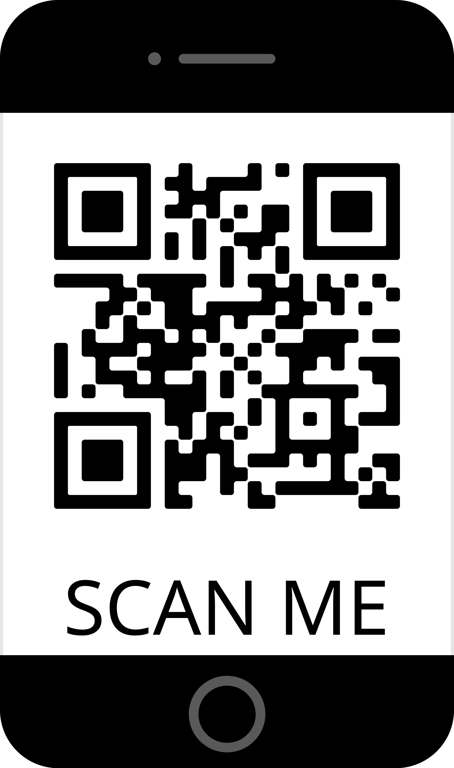
Connect
bmcfarland@homefirstscc.org
https://www.linkedin.com/in/bmichaelmcfarland/

Slide 27
OBSTACLE SCHMOBSTACLE!
How to go over, under, around, and through to get your YES
B. Michael McFarland
Chief Development Officer
HomeFirst

