Slide 1
Houston, we have a problem! 10 reason why your organization needs a crisis management plan
Tuesday, April 18
10:15am

Slide 2
Shelly Maharry, MPA President and CEO

Slide 3
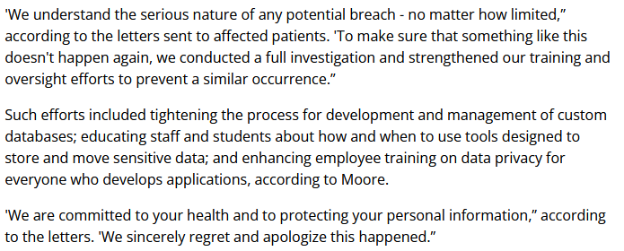
“We understand the serious nature”
“tightening the process”
“Negligence”

Slide 4
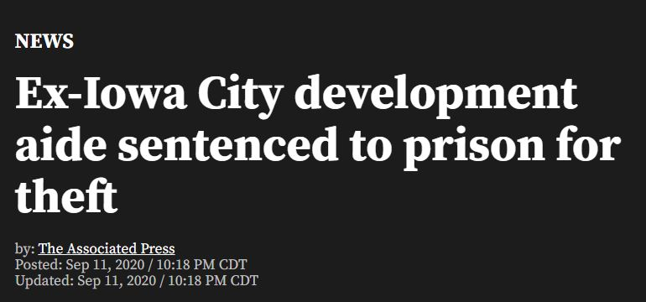
Report “White nationalist group given grant by Foundation”
“13-year theft scheme”

Slide 5
“If you are going through hell, keep going.”
Winston Churchill

Slide 6
How vulnerable are you to a crisis?

Slide 7
How vulnerable are you to a crisis?

Slide 8
Brainstorm your risks: The game to keep you awake at night
Do your staff travel?
Who signs corporate checks?
Do you work with consultants, freelancers, vendors?
Do you store files in the cloud? Do employees work from home?
Are you located next to train tracks, rivers, forests?
Do you operate in countries of political unrest or violence?
Do you have social media presence?
Do you serve alcohol and food at events?
Do you have high staff turnover?
Do staff work with children or clients with disabilities?

Slide 9
What steps can you take to REDUCE Risk?
Revise Policies and Procedures
Insurance Policy Review
IT - Network Security Update
Updated Contact Lists

Slide 10
Are you able to contact the following people in 2 minutes?
Key Staff
Board Chair/Executive Committee
Board of Directors
IT Support/Webmaster
Insurance Provider
Are they able to contact you?

Slide 11
Your Crisis Management Team
Crisis Team Lead: CEO or Board Chair
THE SPOKESPERSON
Executive Committee/Board
Key Staff
Ad Hoc Outside Support
Insurance Provider
Accountant
Depending on the situation, your team will change

Slide 12
The Spokesperson
Must always speak with ONE VOICE
Trusted by staff, board, community
Kept informed of key developments
Have access to key people for questions
Public speaking experience and/or have undergone media relations or public speaking training

Slide 13
Developing your Crisis Management Plan
Identify the crisis trigger: what event will active this plan
Identify the crisis details: who, what, when, where, why, and how
Assess the impact: operations, reputation, revenue, ect.
Awareness: Who already knows about the crisis and how did they learn about it

Slide 14
Developing your Crisis Management Plan
Who should be made aware the crisis and how should they be told
Identify priority action items and set deadlines
Crafting the message: what are 3 to 4 messages you want to have communicated at the crisis; describe how these messages will be distributed

Slide 15
Developing your Crisis Management Plan
Develop a Q&A list about the crisis.
Do we need to establish a hotline or external communication tool?
Resources: what external resources may be needed to address the crisis? Work from home? Laptops, WiFi
Keep a list of important contact information – FIRE BOX

Slide 16
Developing your Crisis Management Plan
Challenges/Opportunities/Red Tape
Who is on the Crisis Management Team
Who will be the Crisis Team Leader
Who will be the spokesperson – who is the back up?
Where will the crisis be managed?

Slide 17
Developing your Crisis Management Plan
What will recovery or success look like?
Distribute the plan to the crisis management team
Document the crisis - keep a list of events and activities completed to address the issue. Remember the lessons learned.

Slide 18
Working with the Media
Development a Media Interview Checklist
Newspaper
Television
Radio
Virtual – zoom
Write your own sound bites
Draft Press Releases & Letters to Editor
Practice being interviewed
Distribute spokesperson headshot

Slide 19
A crisis management plan template has been included in the session materials

Slide 21
Best Practices: When “it” hits the fan
Get the Facts; Activate your Plan
Show Concern
Take Control and Define Success
Communication! Be seen and heard
Set Priorities and Take Action
Ask for help when you need it

Slide 22
10 Reasons why your organization needs a crisis management plan:
Creates a team approach to identifying vulnerabilities
Selects the best person to speak for the organization
Provides a safe space for staff and board to practice
Forms the dedicated Crisis Management Team
Creates Communication Tools in advance
Allows the organization to demonstrate preparedness
Develop CEO Leadership
Positive for Board Recruitment
Reinforces staff confidence in organizational leadership
It’s not if, but when a crisis will happen.

