Slide 1
Board Engagement with
Fundraising
Bill Stanczykiewicz, Ed.D.
Director & Rosso Fellow, The Fund Raising School
Clinical Associate Professor, Indiana University Lilly Family School of Philanthropy
Senior Assistant Dean for External Relations

Slide 2
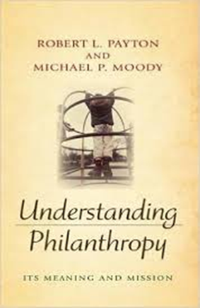
Philanthropy
“Voluntary action for the public good!”

Slide 3
FUNDRAISING
“The gentle art of teaching the joy of giving!”

Slide 4
NONPROFIT LEADERSHIP & MANAGEMENT
Board Development
Strategic Planning
Hire the right people
Operations Planning
Evaluation Plan
Budget
Fundraising

Slide 5
NONPROFIT BOARDS & NONPROFIT EFFECTIVENESS
The board of directors has ultimate legal responsibility over the nonprofit organization (Herman, Renz, & Heimovics, 1997)
High-level engagement from the board of directors is associated with high-level performance of the nonprofit organization (Herman & Renz, 2000)
Board members tend to respond to clear expectations by fulfilling their board responsibilities (Bernstein et al., 2015)
Nonprofits with boards that nurture external relationships tend to enjoy a budget surplus (Brown, 2005)
Board members with a stronger emotional attachment to the nonprofit are more engaged and more likely to make financial donations (Preston & Brown, 2004)

Slide 6
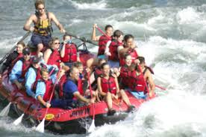

Slide 7
Responsibilities of Nonprofit Board of Directors
Monitoring
Duty of Care
Determine the nonprofit’s mission
Create and oversee the strategic plan
Monitor program results
Fiscal control
Evaluate the CEO
Fiscal control
Rolodex / external relationships
Reducing risk
Charitable donations & fundraising
Duty of Loyalty
Boundary-Spanning
Determine the nonprofit’s mission
Create & oversee strategic plan
Monitor program results
Evaluate the CEO
Rolodex / external relationships
Reducing risk
Charitable donations & fundraising
Conforming
Duty of Obedience
Legal compliance
Legal compliance
(Miller-Millesen, 2003)

Slide 8
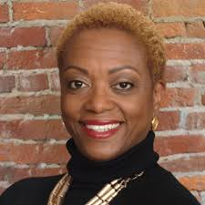
DIVERSITY
Vernetta Walker

Slide 9
HOW BIG? HOW OFTEN?

Slide 10
STRUCTURING THE BOARD OF DIRECTORS
Committees
Executive
Board Governance
Budget and Finance
Fund Development
Task Forces

Slide 11
BOARD MEETING AGENDA
Consent Agenda
Mission Moment
Committee Reports
Executive Director’s Report
Big Question/Big Idea/Big Opportunity

Slide 12
Nonprofit Boards and Fundraising
Only 46 percent of nonprofits have 100 percent board giving
Only 40 percent of nonprofit CEOs describe their boards as actively participating in fundraising
Nonprofit CEOs – fundraising is a top responsibility of board members
Board members were asked about external stakeholders with whom they should meet:
The number who were asked =
169
0
The number who cited donors and prospective donors =
(BoardSource, 2017; BrideSpan, 2018; Holland, 2002)

Slide 13
WHY PEOPLE HESITATE TO FUNDRAISE
Not polite to talk about money with other people
I will look silly or awkward
If they donate to me, I will be expected to donate to them (“quid pro quo”)
More than money, you are inviting them to join you in the ways that you are making the world a better place!
This is not about you. This is about the cause. The nonprofit’s impact. The people being served!
Yes. #Adulting!
“Fundraising is the gentle art of teaching the joy of giving!”

Slide 14
Reasons Why Nonprofit Board Members
Should Donate & Fundraise
Legal
Support strategic plan & mission
Lead by example
Fundraising & External Relationships

Slide 15
BOARD ENGAGEMENT & FUNDRAISING
Board Membership = Selective Recruitment & Retention of board members – recruiting and retaining the right people and the right number of people on the board
Passion for the nonprofit’s mission
Understanding and willingness to fulfill board member responsibilities
Removal of underperforming board members
“If you’re unwilling, then I need to know that. I don’t want to waste your time. We’ll move on to somebody else. Don’t become involved. If you feel strongly about not (making a charitable donation), then don’t take a (board) seat from someone who could. Resources are limited, (but) people are plentiful.”
HOW
Governance committee “Grandfather Clause”
Memorandum of Understanding Attrition (term limits)
Rigorous vetting of prospective board members Removal
(Stanczykiewicz, 2020)

Slide 16
BOARD ENGAGEMENT & FUNDRAISING
Expectations = strongly associated with board member fundraising participation
The odds of board member fundraising are 11 times higher when preceded by Expectations
“We try to paint the clearest picture possible of what they’re getting themselves into so that there are no surprises. We go through ten different things that we expect from a board member, and one of them is (charitable) giving.”
“I’m not seeing anybody say anything negative. I don’t sense that anybody’s been offended.”
HOW
Written “Memorandum of Understanding”
Board Manual
Verbal communication
(Stanczykiewicz, 2020)

Slide 17
BOARD ENGAGEMENT & FUNDRAISING
Fundraising Committee = associated with board member participation in fundraising
The odds of board member fundraising nearly double due to a fundraising committee
“The biggest thing they do is they ask (other board members), ‘We’re interested in a corporate donor for X project. What type of network or connections or relationships does anybody on the board have with this entity?”
HOW
Bylaws
Formal committee description
Recruitment
Strategy
Board member fundraising
(Stanczykiewicz, 2020)

Slide 18
BOARD ENGAGEMENT & FUNDRAISING
Peer-to-Peer Encouragement = board members encouraging each other can increase board participation in fundraising
“Our board chair said to his peers, ‘We need to have 100 percent giving, and levels will vary. We’re not asking for a particular amount.’ There were nodding heads and checks being written.”
“Board members can (encourage fundraising) and say that once, and it’ll resonate. I (the CEO) could say that 10,000 times, and it won’t. There’s a lot of peer-to-peer communication.”
“It’s a peer-to-peer ask. (The board member) will say, ‘This is why I give. Won’t you join me in giving?” That’s the primary thing.”
(Stanczykiewicz, 2020)

Slide 19
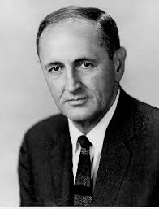
BOARD ENGAGEMENT & FUNDRAISING
Ongoing Engagement = Activities allowing board members to remain informed about – and be involved with – the nonprofit’s programs, services, and fundraising
“In this last board meeting, after the mission moment, we had one board member say, ‘I change my pledge.’ In the meeting she (increased) her pledge because she realized just how important her investment is.”
HOW
Mission Moment
Invites to programs & events
Quarterly luncheons
Donor meetings
Donor stewardship
Apparel
Board retreats
“I recommend some carefully conducted tours of the front lines.” – John W. Gardner, “Leadership and the Nonprofit Sector,” 1990)
(Stanczykiewicz, 2020)

Slide 20
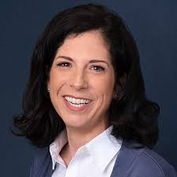
BOARD ENGAGEMENT & FUNDRAISING
Key Staff = The CEO and other senior fundraising staff members remaining highly engaged with board members to encourage their involvement, including with fundraising
“(The CEO’s) passion is contagious. She’s very articulate. She has a passion that radiates, and that’s engaging.”
“(The chief development officer) comes to our board meetings, and he gives us his results, and then sends us personal e-mails. It’s nice to be recognized without somebody just always expecting something from you.”
Ann Fitzgerald
(Stanczykiewicz, 2020)

Slide 21
POTENTIAL CONCERNS
OUR NONPROFIT IS…
Too late
Grandfather existing board members until their next term
Too small
three-fourths of nonprofits have budgets of less than $1 million
Too resistant
use change leadership tactics and peer-to-peer encouragement
Too hesitant
fundraise with confidence, starting with your board

Slide 22
BOARD-REGARDING BEHAVIORS
Consistent interaction with board members
Showing respect to board members
Prompt board with ideas for organizational change and innovation
Promote board accomplishments
Provide info to board in a timely manner
(Herman & Heimovics, 1990)

Slide 23
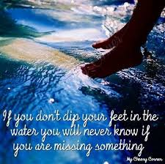
BOARD MEMBERS & FUNDRAISING: Initial Steps
Make a personal donation
Attend board meetings & engage in oversight of strategy & mission – revealing why funding is needed
Provide fiscal oversight – revealing how much funding is needed
Write thank you notes to donors
Write thank you e-mails to donors
Make thank you phone calls to donors
Talk about the nonprofit within circles of influence
Make introductions to companies and other organizations
Host an event to introduce people to the nonprofit
Provide names of prospective donors
Introduce the nonprofit to those prospective donors
Attend a fundraising solicitation with a staff member

Slide 24
Board Engagement with
Fundraising
Bill Stanczykiewicz, Ed.D.
Director & Rosso Fellow, The Fund Raising School
Clinical Associate Professor, Indiana University Lilly Family School of Philanthropy
Senior Assistant Dean for External Relations
billstan@iu.edu
@_billstan

