Slide 1
Amplifying Giving Day Success With Omnichannel Engagement
Greta Daniels, CFRE
Senior Vice President

Slide 2
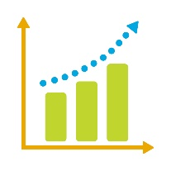
Why invest in a giving day?
Best acquisition vehicle
All your channels, pointed to one effort
Social listening, micro-volunteering
Identify future LAG/MG Prospects
Future philanthropy builder: a rallying cry
Highest ROI in fundraising today

Slide 3
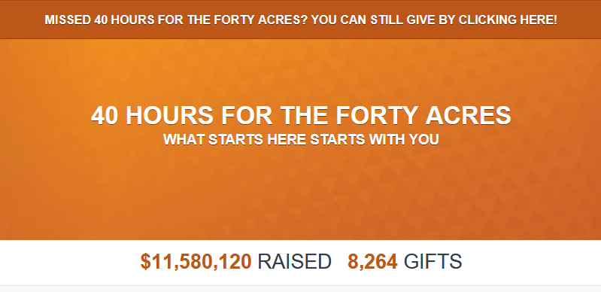
Giving Day Benchmarks
$143 - average online gift for a giving day in 2022
77% of total dollars come from offline gifts
73% of gifts come online
Notes:
Maile and Brian on stats

Slide 4
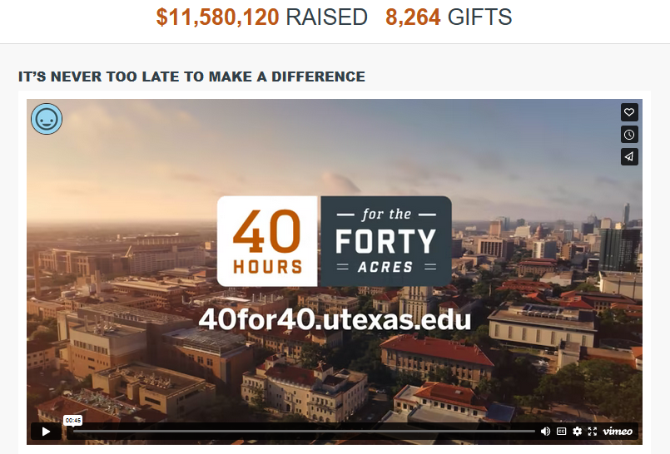
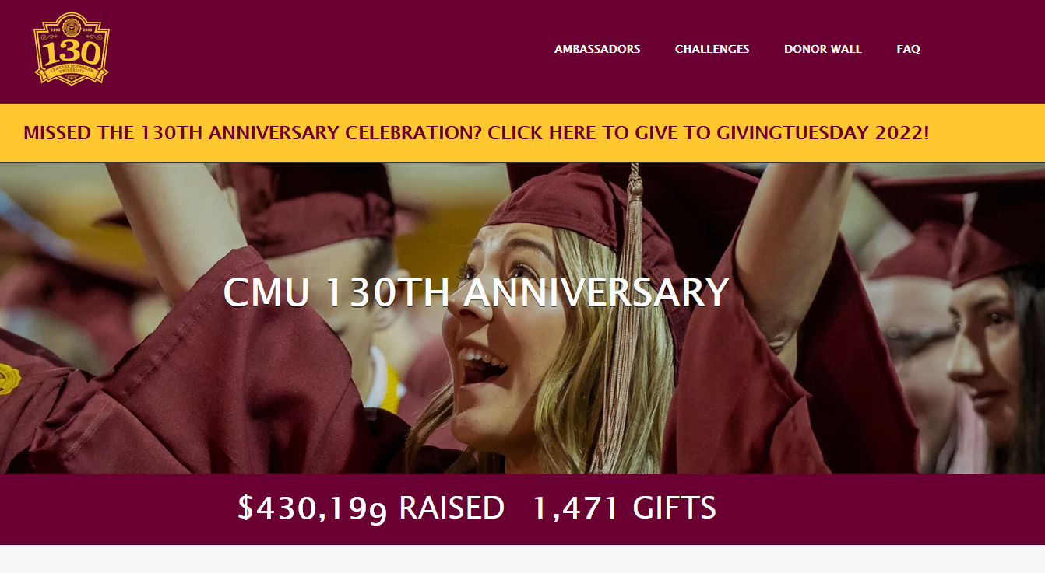
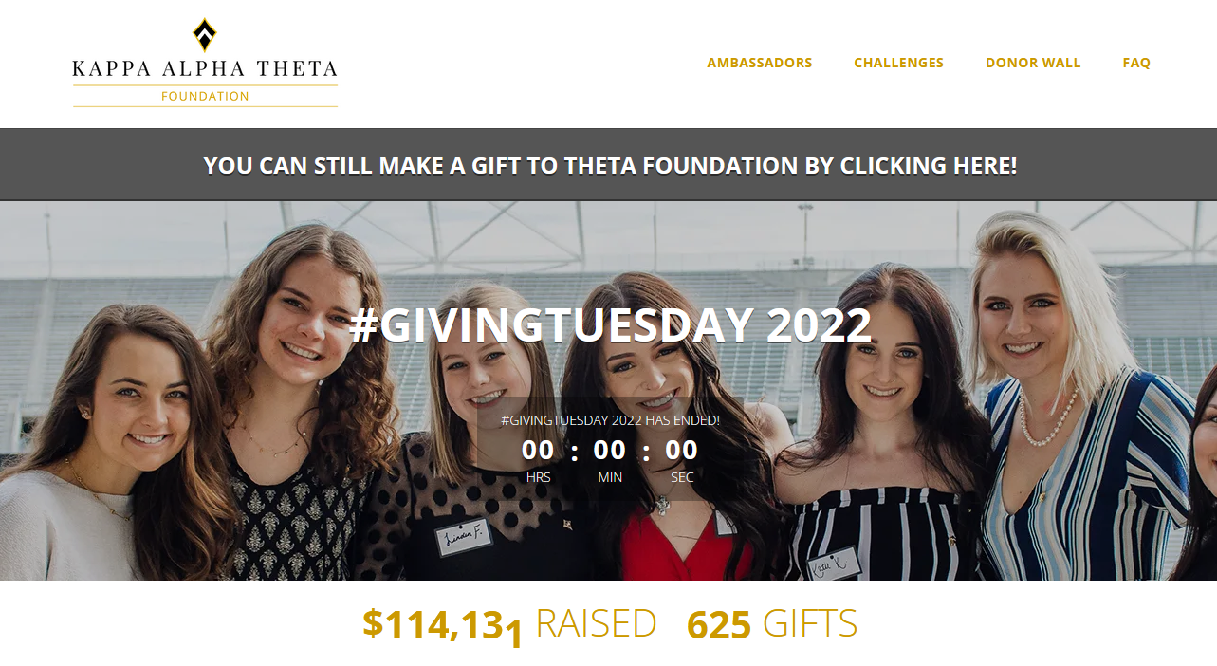
The Giving Day Revolution
Who is leading the way?

Slide 5
Giving Day Hurdles
Big giving days take months of planning.
Staffing is an issue everywhere.
Leadership and MGOs must buy in.
Resources are tight.

Slide 6
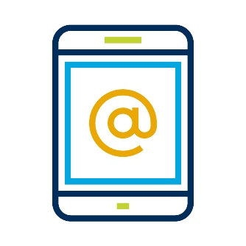
These hurdles make it hard to do the key thing:
Omnichannel Engagement

Slide 7
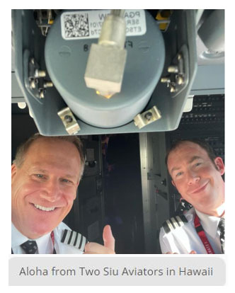
What does omnichannel look like?
A #GivingTuesday warming/engagement text to over 20,100 alumni at Southern Illinois University–Carbondale got this awesome response from two SIU pilots as they got ready to take off.
The alumni sent in a gift and even encouraged SIU to use the pic in promotion!

Slide 8
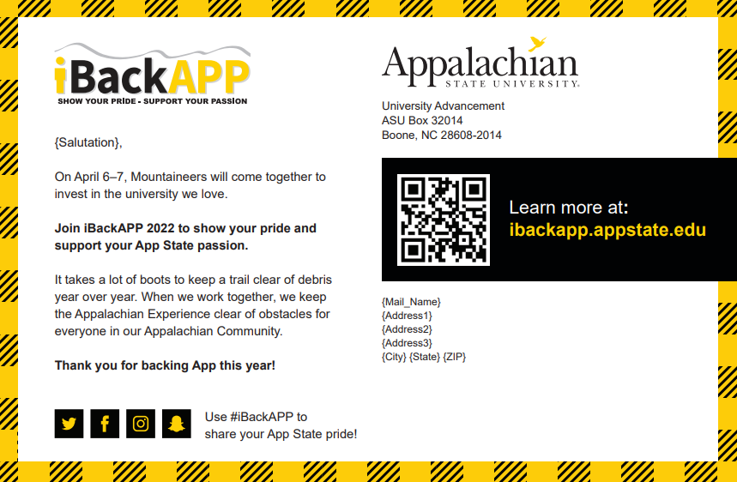
What does omnichannel look like?

Slide 9
What does omnichannel look like?

Slide 10
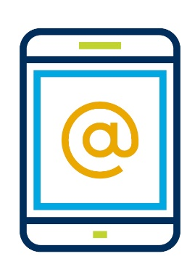
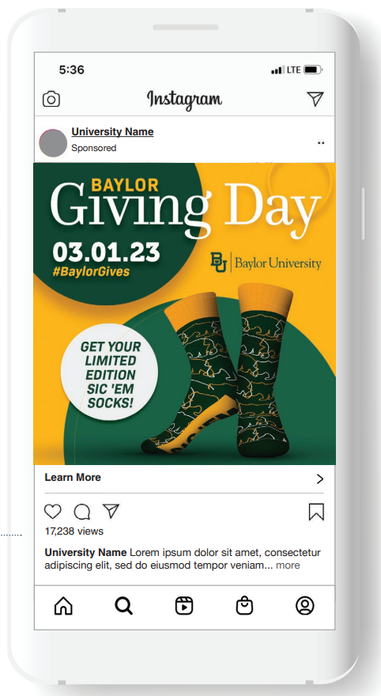
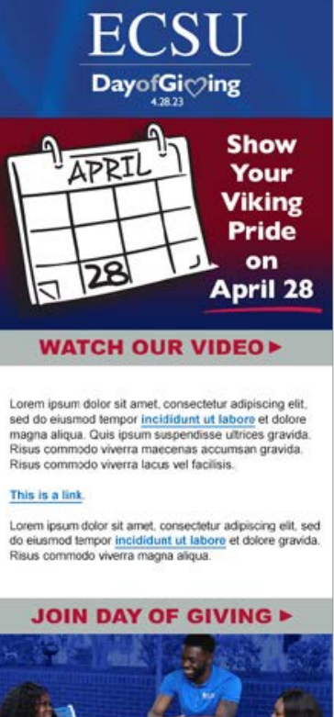
What does omnichannel look like?

Slide 11
Why
?
Built with the donor experience and fundraiser needs in mind.
Branded to your organization, creating a seamless integration.
Unlimited fundraising. Uses your gift processor.
Track online and offline gifts easily.
Customized challenges, matches and competitions.
Volunteer ambassador enablement tools and tracking.
Always evolving, and a community.
$910M
Raised on the platform since creation

Slide 12
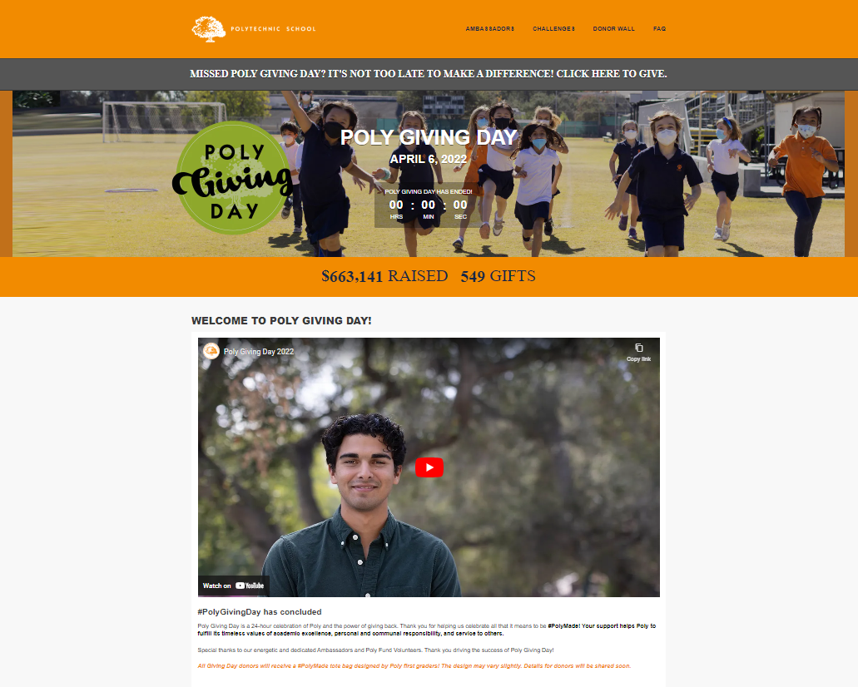
Customize Giving Day Pages to Reflect Your Brand
Customize branded landing pages for different areas or units of your institution by harnessing department pages
Order components of your giving day page through custom layout options
Showcase an unlimited number of matches, challenges, and leaderboards
Update donors on campaign progress through email updates
Create shortened Print URLs
Set up a custom domain to match your institution domain
Notes:
Theresa
One of the most important aspects of our giving day product is that we want this to feel like YOUR website.
Even looking at the very basics – text, button, background colors – we want these to reflect your branding and colors. We’ll help to design the platform to fit your branding guidelines, so that it really does look and feel like your website.
Depending on your priorities for your day of giving, you can:
Create an unlimited number of landing pages—so you could have lots of different causes and landing pages that your donors can visit, or just one if that makes more sense for you.
Choose between two layouts which I’ll talk more about in a minute.
You can have an unlimited amount of matches, challenges, and leaderboards
Create shortened Print URLs for your solicitations and sharing on social.
You’ll also be able to create and choose the custom domain for your platform – we’re looking at Ball State here…. So givingday.ballstate.edu for example… this just further customizes your platform and makes it really feel like it’s your giving day.
We recognize that giving days across institutions have a wide array of priorities and your giving day page needs to reflect those priorities, so we don’t like to restrict you – we want you to be able to showcase as many priorities as you want and as many matches and challenges that you want.

Slide 13
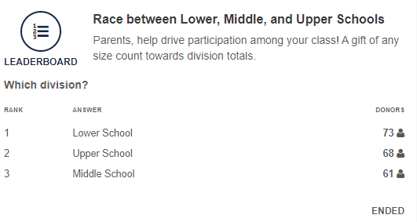
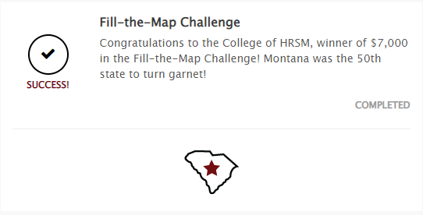
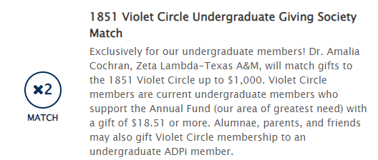
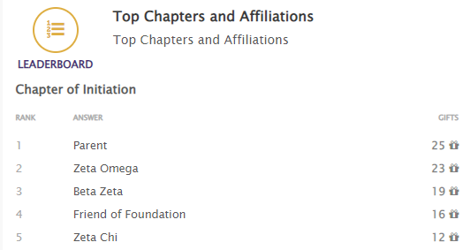
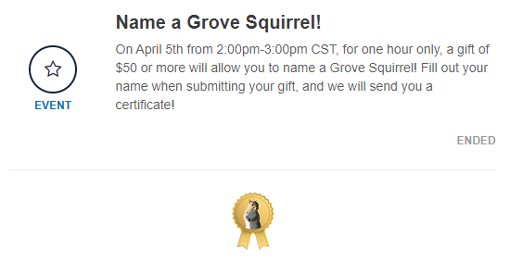
Flexible & Automated Gamification
Notes:
Theresa
We know matches increase likelihood of giving by 27% so we want these to be readily available and used on your giving day.
The events functionality also helps to simplify some of the work required by your team. These events run and tabulate automatically cutting out some of that legwork.
Matches: Straight forward dollar for dollar.
Challenges: Unlocking a reward for hitting a certain number of gifts or total raised.
Leaderboards: You can rank your different areas of giving – colleges, funds, teams - based on dollars raised or gifts made. You can offer rewards or you can simply just rank the areas.
Custom Event: We see these used most often for social media challenges. Anything that might not be tracked through the platform, but that you want to advertise.
All of the events can be set based on global, funds, or departments. They can also be set up by duration – all of giving day, follow up to another event, or power hours as we call them.
Events can also be set up based on affiliations or class years. Anything you are asking your donors to identify while they are making a gift.
Offline gifts will count as long as they meet the criteria of the event.

Slide 14
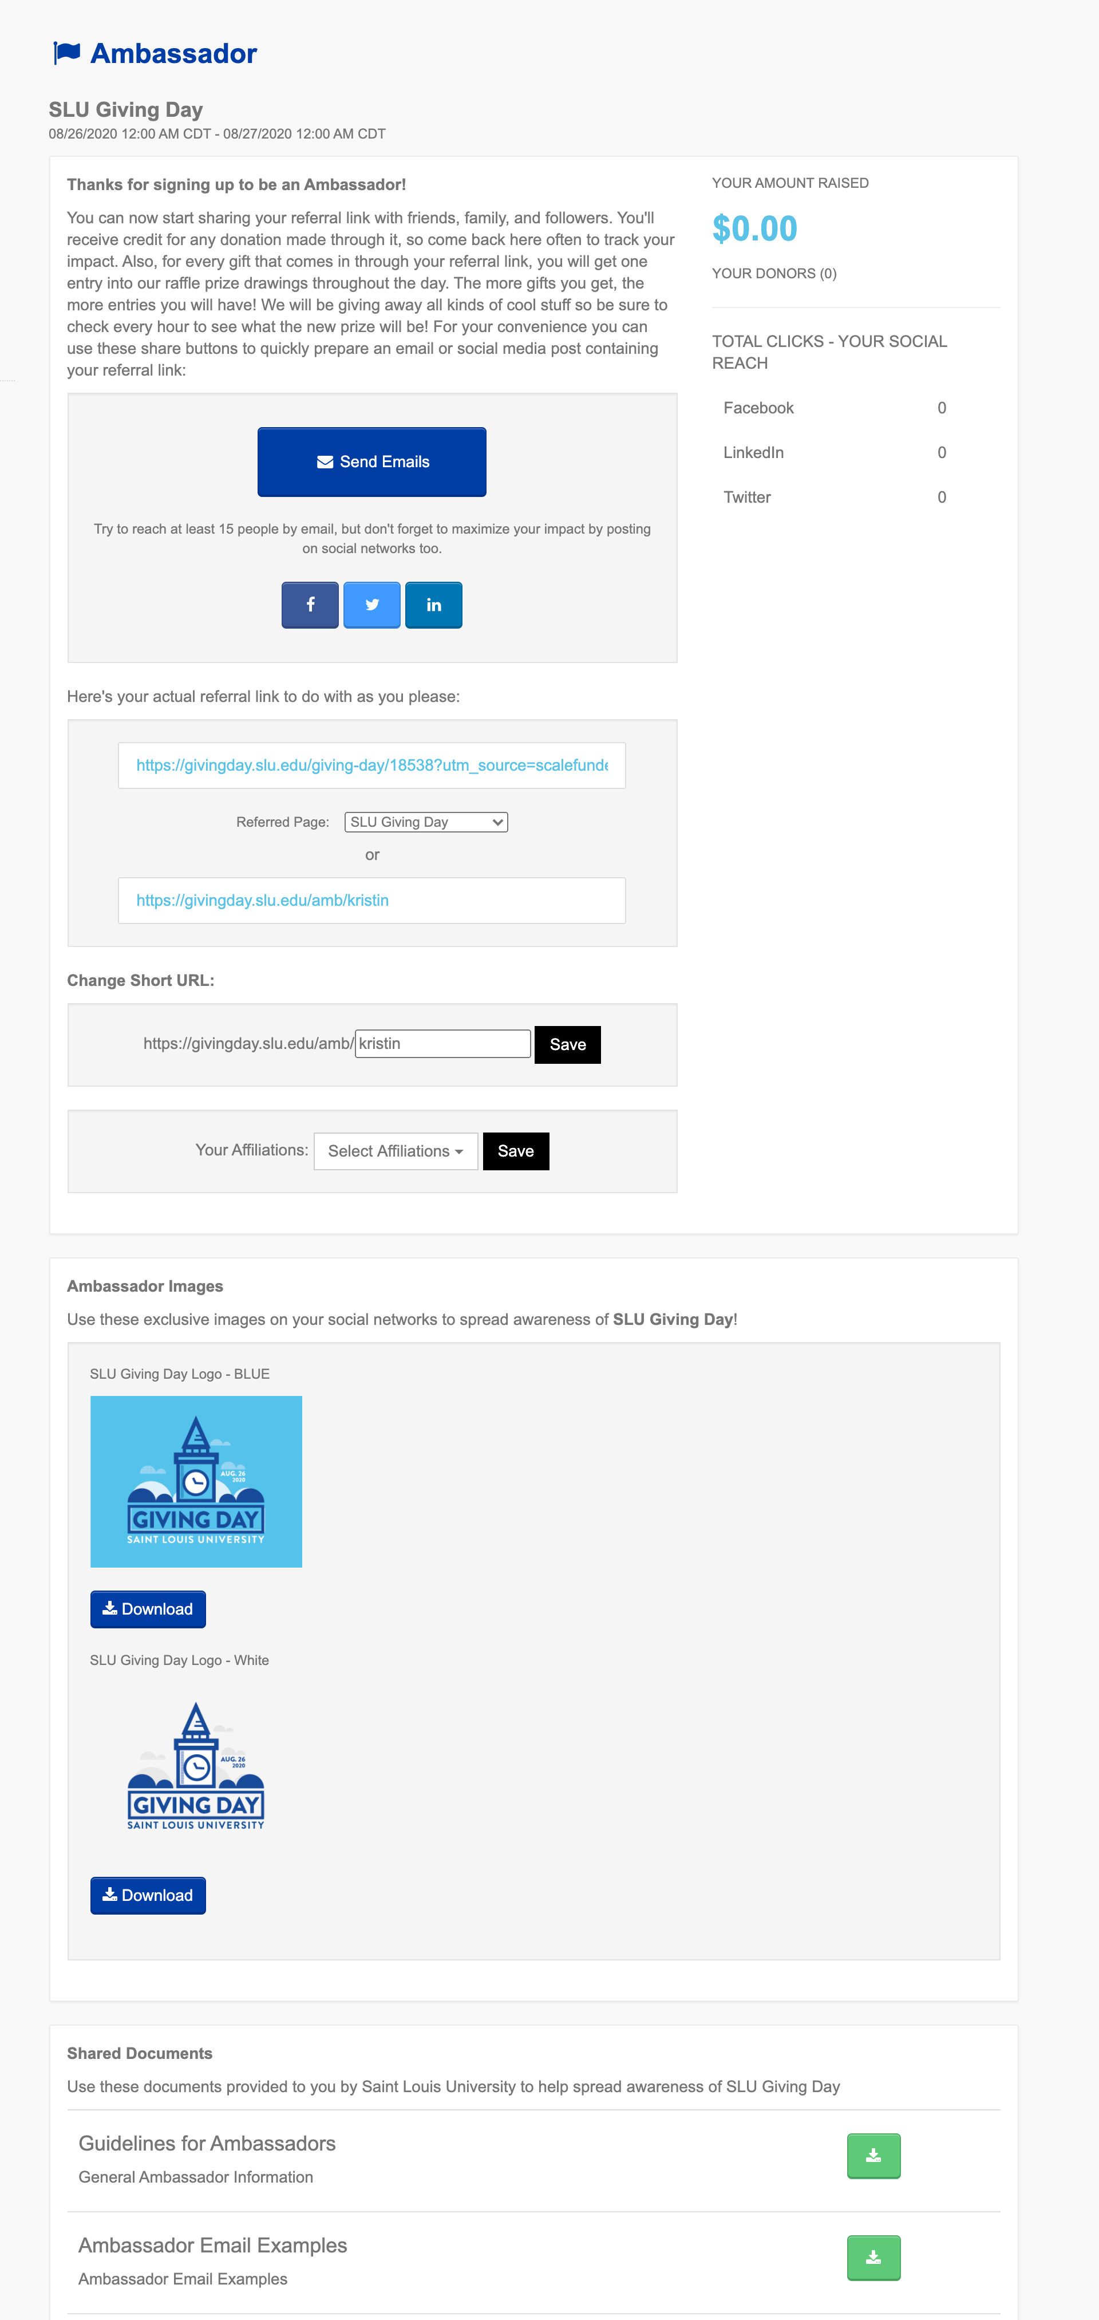
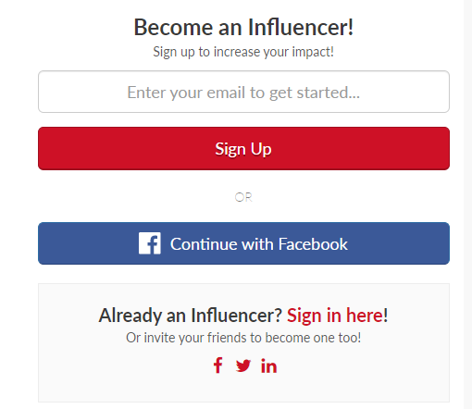
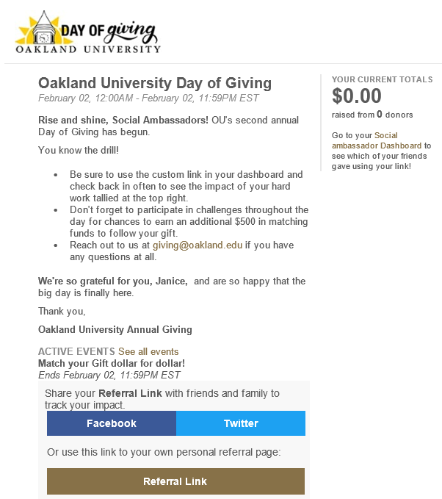
Recruit and Equip Ambassadors
Notes:
2
Our ambassador feature has very robust capabilities.
Ambassadors can be added by admins on the back-end of the platform or sign up directly on the giving day page.
Ambassadors will have access to a type of command center – their Ambassador Dashboard.
Ambassadors have a trackable URL that will pre-populate in any of these share buttons.
They are able to track how much they have raised and see their donors and how many people are clicking through on their posts.
You all can help to encourage sharing by uploading multiple images, guides, or documents that the ambassador can download at any time.
You are also able to track the impact of ambassadors on the back-end of the platform – seeing totals, shares, and clicks. This is all included in a downloadable report as well.
You may be thinking, how do we even begin to create an ambassador program for our giving day – where do we even start with that? Part of the strategy sessions we do with our clients is help you understand how to build a solid ambassador program for your giving day. And in addition to that we can do a training FOR your ambassadors – walk them through the sign-up process and how to be the most effective ambassador. Again, that takes some of the work off your plates. The CSC’s role is really to be an extension of your team and help lessen the load for you.

Slide 15
ScaleFunder Ambassador ROI Analysis – First RNL Giving Day
0 ambassadors
$59,560 online dollars
356 online gifts
1 – 50 ambassadors
$67,737 online dollars
461 online gifts
51 – 100 ambassadors
$181,677 online dollars
1,140 online gifts
101 – 180 ambassadors
$182,846 online dollars
1,531 online gifts
101 – 180 ambassadors
207% dollars
330% gifts
51 – 100 ambassadors
205% dollars
220% gifts
Notes:
Brian will ask Amanda: How should we use volunteers?
Giving Day New Clients: 29 clients and 31 giving days
For new ScaleFunder clients, 51 – 100 ambassadors provides the best ROI for dollars raised.
205% dollars
220% gifts
If the goal is to increase participation, 101 – 180 ambassadors provides the best results.
207% dollars
330% gifts
1-50 ambassadors
14% dollars
29% gifts

Slide 16
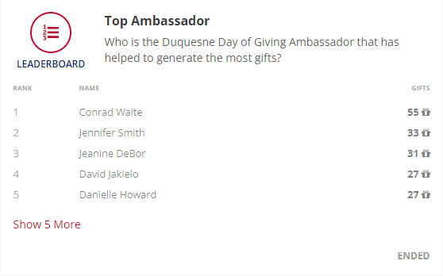
Ambassadors are Path to Giving Day Success

Slide 17
Key Giving Day Trends
What we’re hearing
Multiple Giving Days
Increased Use of Ambassadors
Specific Impact Causes
More matches/challenges
Corporate/Foundation matches
Longer Giving Days
Making Giving Easy
Competitions
Power Hours
AI Personalization

Slide 18
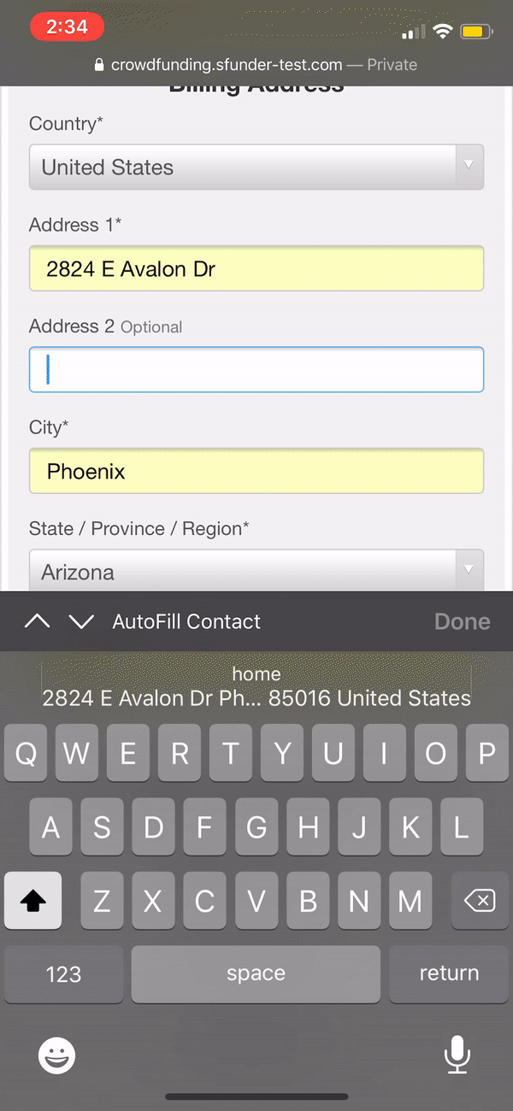
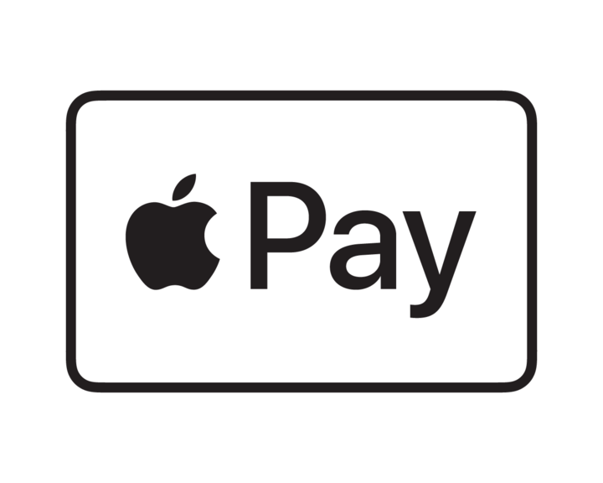
More Digital Wallet Options:
RNL
Preferred
Payment
Notes:
Brian
RNL is excited about our partnership with Braintree.
Benefits to our clients include:
Digital Wallet options like Venmo, PayPal Checkout, and Apple Pay
2.2% + $0.30/transaction discounted processing fee with proof of 501c3 status (Starting August 2, 2021--- 1.99% +.49 per transaction)
Express Onboarding from PayPal team (PayPal owns Braintree)--this includes assistance with application and quicker timeline to approval
Please let the CSC team know about any new and existing ScaleFunder clients who are interested in Braintree. The CSC team will make initial onboarding introductions between Braintree and the client.
While our clients have a separate relationship with Braintree as their payment processor, both Theresa and Maile should also be included in any introductory/onboarding meeting with Braintree to ensure a quick and seamless integration.

Slide 19
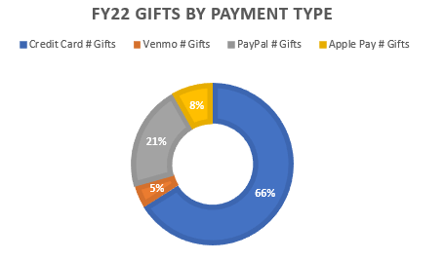
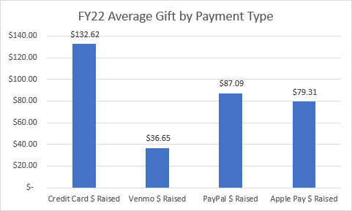
Gifts in less than a minute with digital wallet
RNL + Braintree Digital Wallet Stats
26,984 Online Gifts
34% of Gifts were made using one of the 3 digital wallet options.
Gifts made via digital wallet made up 23% of online dollars raised.
Venmo gifts saw a much lower average gift, $37. We believe that many of these are first time, younger donors.
Notes:
Brian
Case Study featuring Santa Clara University: https://www.ruffalonl.com/papers-research-higher-education-fundraising/santa-clara-university-fuels-record-giving-day-success-with-digital-wallet/
Brian asks Amanda and Dave, why do digital wallet: Dave

Slide 20
Going Beyond Software
$148
How RNL can make your Giving Day even better:
A turn-key solution.
Comprehensive, omnichannel strategy to drive results.
You set the vision, and we relieve your staff of burdens.
Channels operated in coordination.
Expert guidance, training and consulting.
We make it easy on your advancement services team.
Average online gift for giving days, 2022

Slide 21
Expert Consulting Support
From a team that has assisted with over $1B in giving day support
Assessment
Review and assess giving day priorities and needs
Determine areas of opportunity
Identify methods for implementation and execution.
Increase involvement and exposure with leadership, campus partners, and other stakeholders
Get feedback with custom internal survey,
Convene with a virtual or on campus visit
Receive a custom report with tactical and strategic recommendations
Strategic Planning
Goal Setting,
Establishment of KPIs, projections and timelines
Communication Plan
Challenges, Matches, Competitions – Gamification Strategy
One day onsite (or virtual) team training

Slide 22
What’s included:
 |  | Select | Advanced
Software | Giving Day powered by RNL ScaleFunder | ✓ | ✓
 | Crowdfunding powered by RNL ScaleFunder |  | ✓
 | Evergreen Giving Pages powered by RNL ScaleFunder |  | ✓
 | RNL QuadMail |  | ✓
Direct Marketing | Pre-Event Postcard | ✓ | ✓
 | Pre-Event Email Campaigns | 1 | 3
 | Event Email Campaigns | 3 | 3
 | Event Phone Campaign | 50 hours | 100 hours
 | Pre-Event Text Campaign |  | ✓
 | Event Text Campaign | ✓ | ✓
 | Digital Advertising Campaign | ✓ | ✓
 | Personalized Video with Allied Pixel |  | ✓
 | Personalized Video with ThankView | If Applicable | If Applicable
Training and Consulting | Platform Technical Training | ✓ | ✓
 | Giving Day Assessment | ✓ | ✓
 | Giving Day Strategic Planning |  | ✓
Stewardship | Thank You Email Campaign |  | ✓
 | Thank you/Stewardship Handwritten Cards (up to 5K) |  | ✓
Brand | Custom Creative (Logo Design) | Price at Request | Price at Request

Slide 23
Who is RNL Giving Day designed for?
Orgs with limited staff bandwidth
Orgs that want to take day to next level
Orgs launching multiple smaller giving day initiatives

