Slide 1
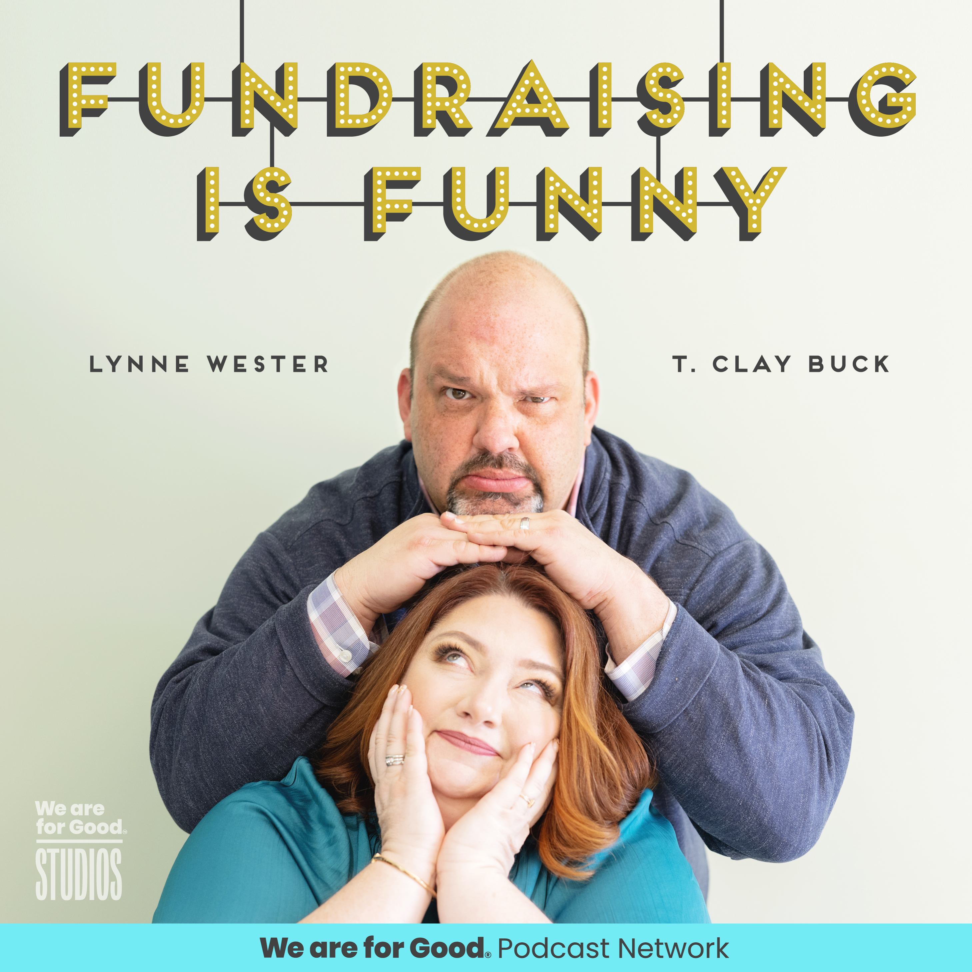
T. Clay Buck, CFRE and Lynne M. Wester and the cast of TED LASSO
"Fundraising is Life"
How to reenergize yourself and your fundraising

Slide 3
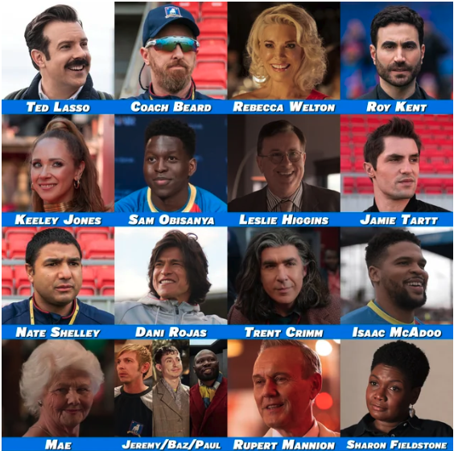
Fundraising Identification Time!

Slide 4
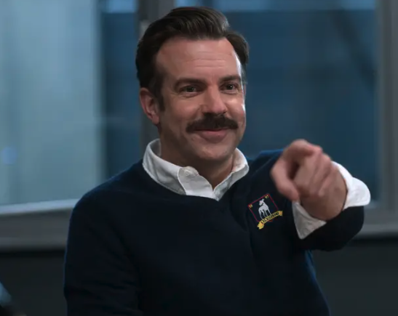
What’s Your WHY?

Slide 5
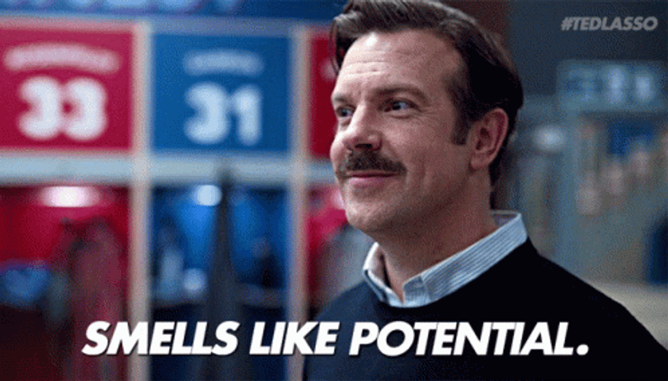
RECOGNIZE

Slide 6
COVID-19
Racial Unrest
Economic Uncertainty
Civil Conflict
Great Resignation
YOU

Slide 7
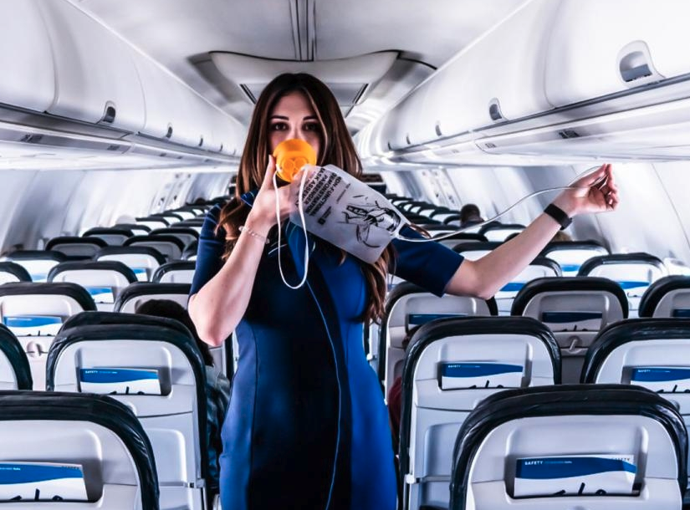
Let’s Talk Masks

Slide 8
Self Care is Essential

Slide 9
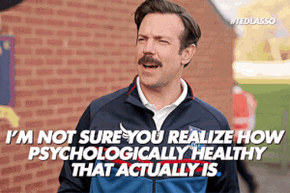
Jamie Tartt: “Coach, I’m me. Why would I want to be anything else?”

Slide 10
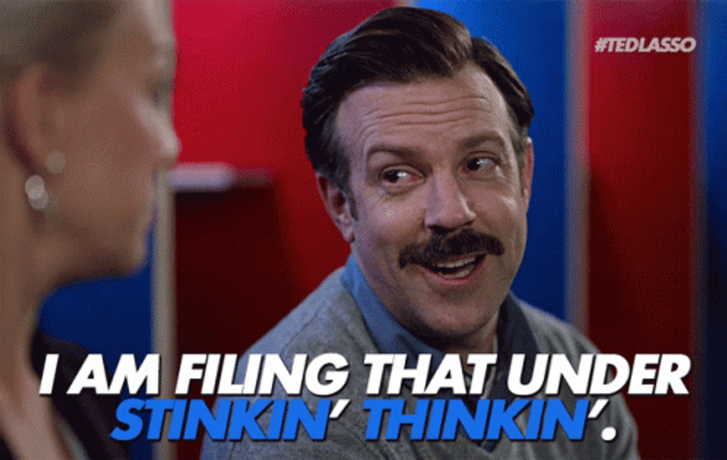
REVEAL

Slide 13
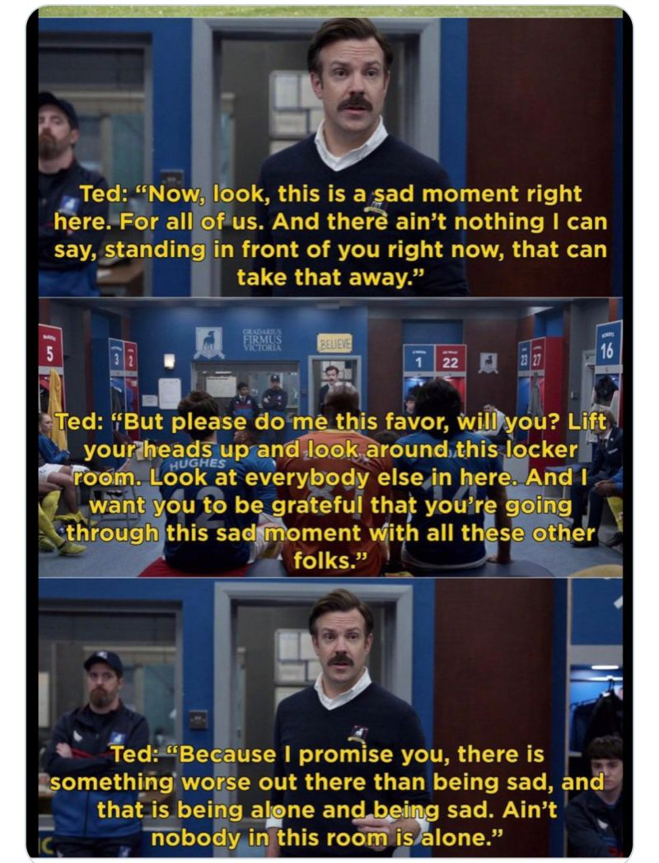

Slide 14
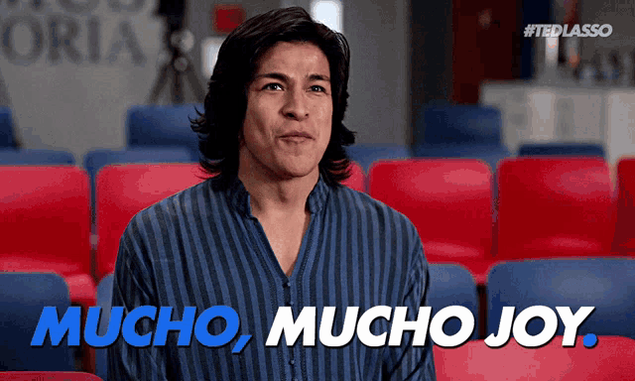
REFRAME

Slide 15
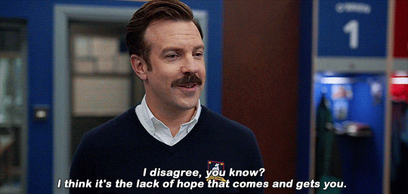
Winning is an
attitude

Slide 16
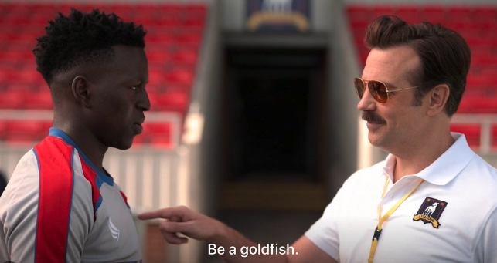

Slide 17
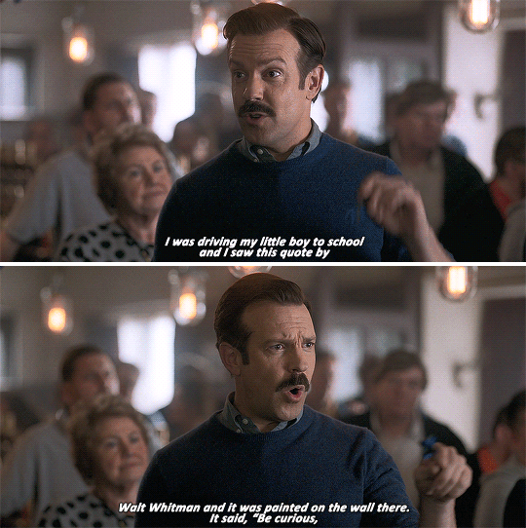
Be Curious
Not Judgmental

Slide 18
Empower
Others

Slide 19
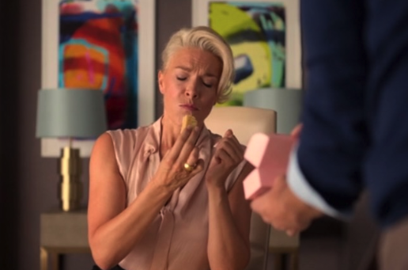
Schnacks build relationships

Slide 20
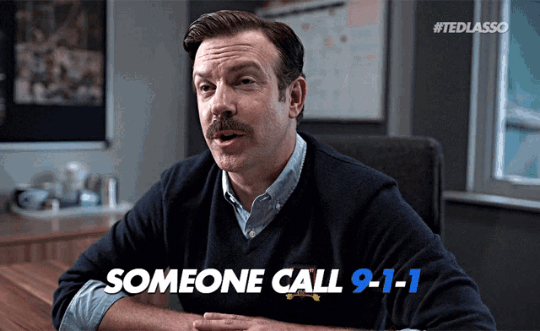

Slide 21
Thank You!!
Contact Us
www.fundraisingisfunny.com
Clay@tcbfundraising.com
Lynne@donorrelations.com

