Slide 1
fundraising innovation: how a Canadian organization is leading the way

Slide 3
Glenbow re-imagined (inside/out)
our objectives are to share the:
‘factors’ that set the stage for for Glenbow’s transformation.
roles of the ‘fundraiser + philanthropist’ in realizing the vision.
strategy that allowed Glenbow’s campaign to ‘future proof’ its mission

Slide 4
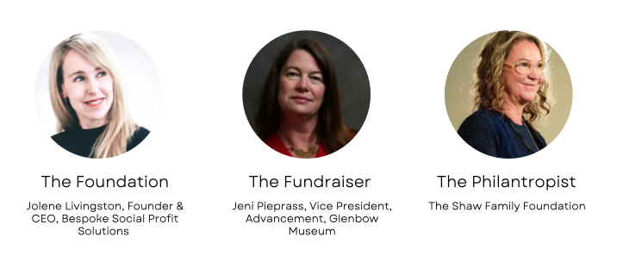

Slide 5
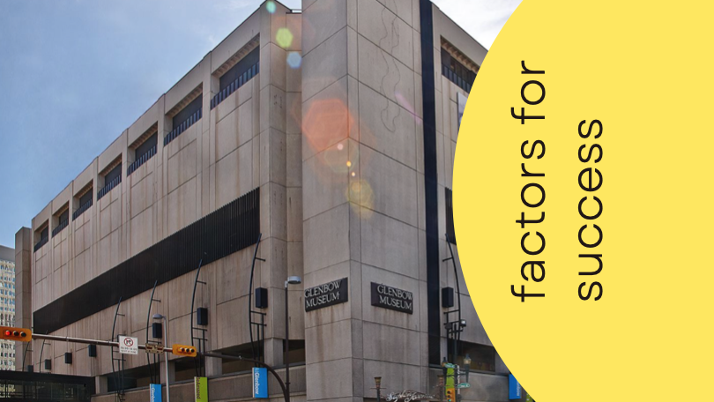
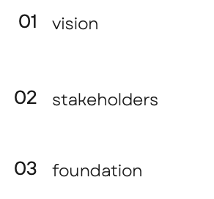

Slide 6
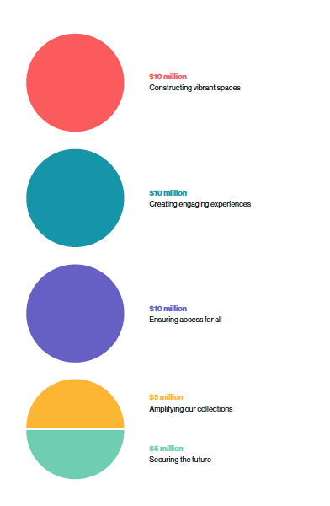

Slide 8
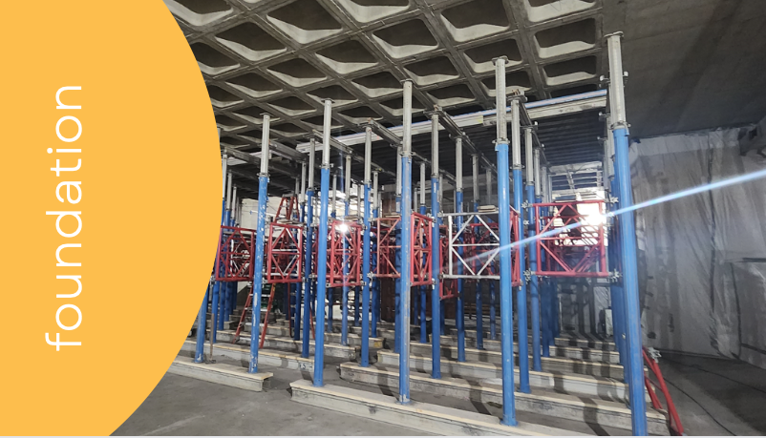

Slide 9
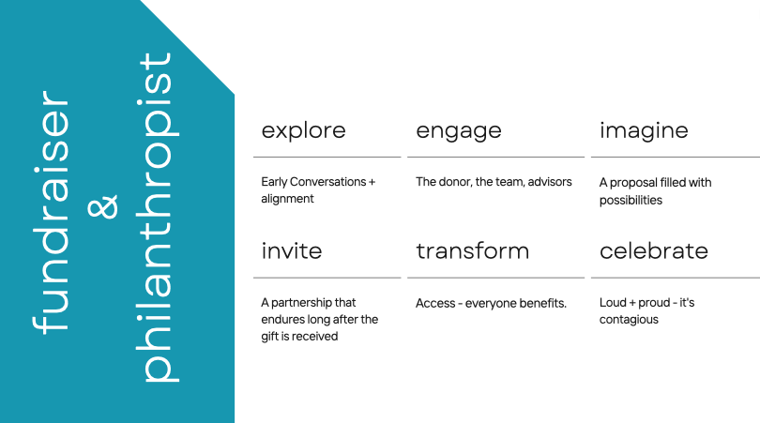

Slide 10
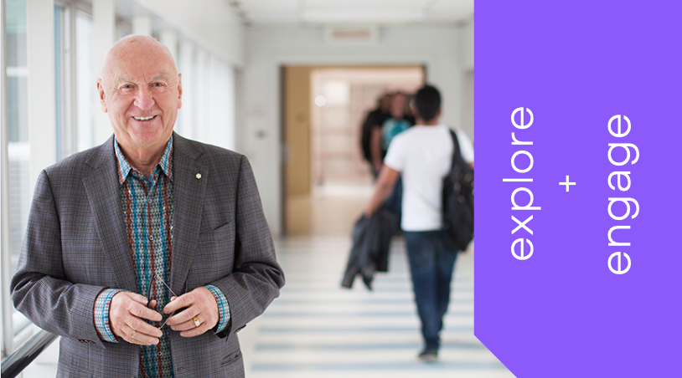

Slide 11
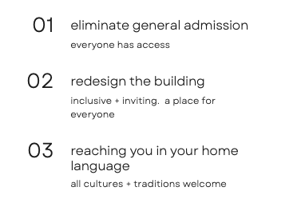

Slide 12
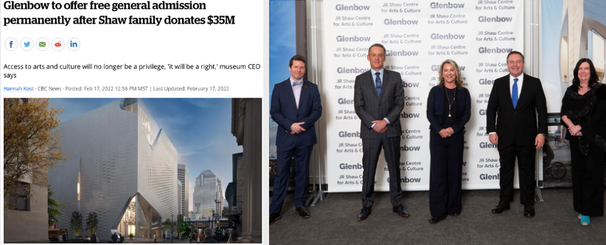

Slide 13
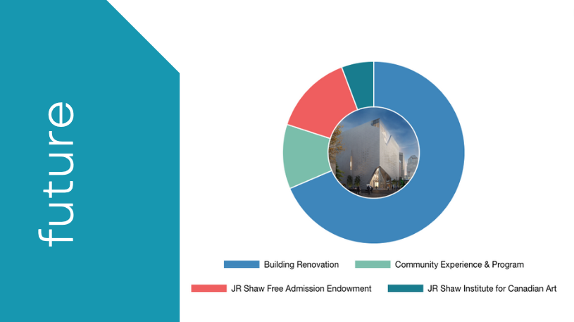
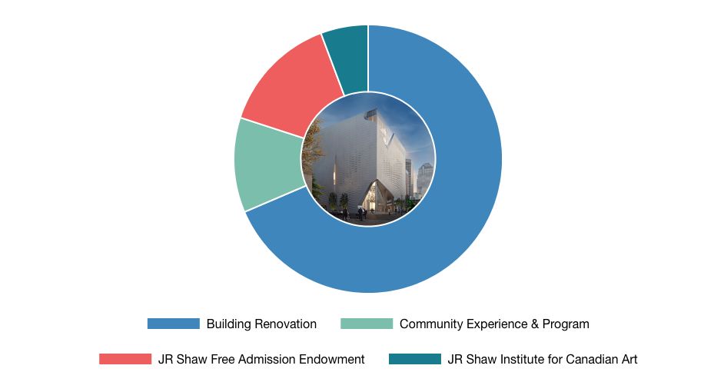

Slide 14
