Slide 1
Activating an Equity-centered Development Department
IDEA – Inclusion, Diversity, Equity, Access
Session sponsored by

Slide 2
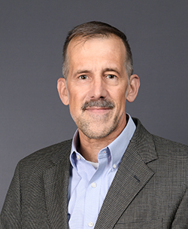
Welcome!
Brenda Asare
President & CEO
John Huebler, CFRE
Senior Associate Director, Major Gifts

Slide 3
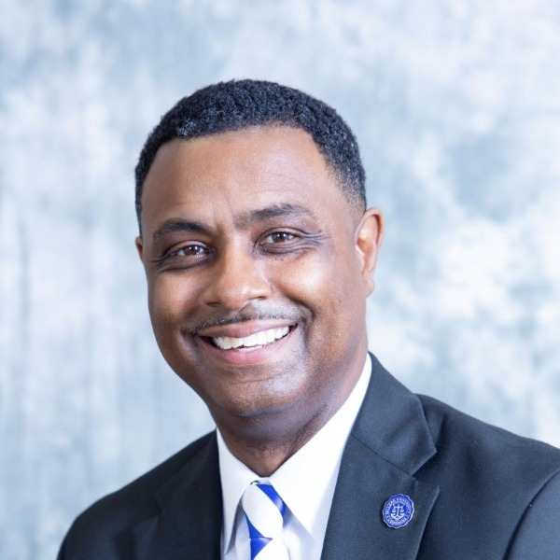
Marc A. Barnes, Ph.D., CFRE
Sr. Vice President
Principal Gifts & Strategic Impact Investment Fund, UNCF
Moderator

Slide 4
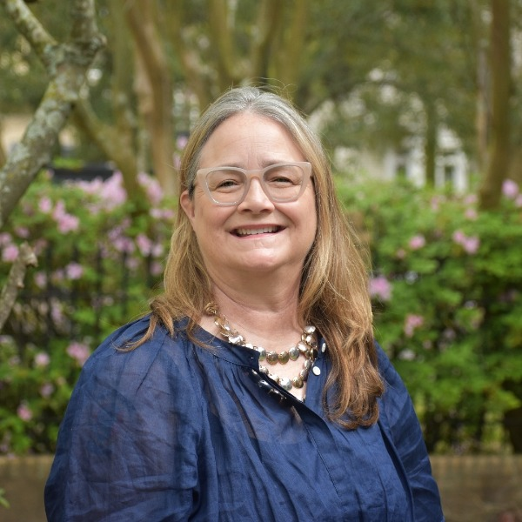
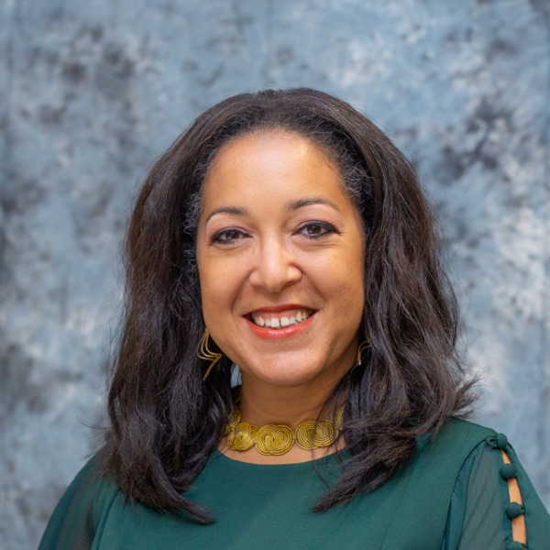
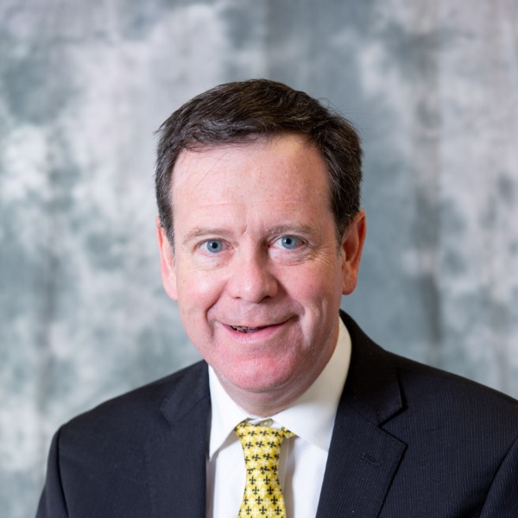
Caroline Durham, J.D. Executive Director
St. Charles Center for Faith + Action
Alisha Johnson Perry, CFRE
Director of Donor Programs
Gulf Coast Community Foundation
Caitlin Scanlan
Chief Development Officer
Reconcile New Orleans, Inc. | Café Reconcile
Cory Sparks, Ph.D.
Major Gift Officer
Dillard University

Slide 5
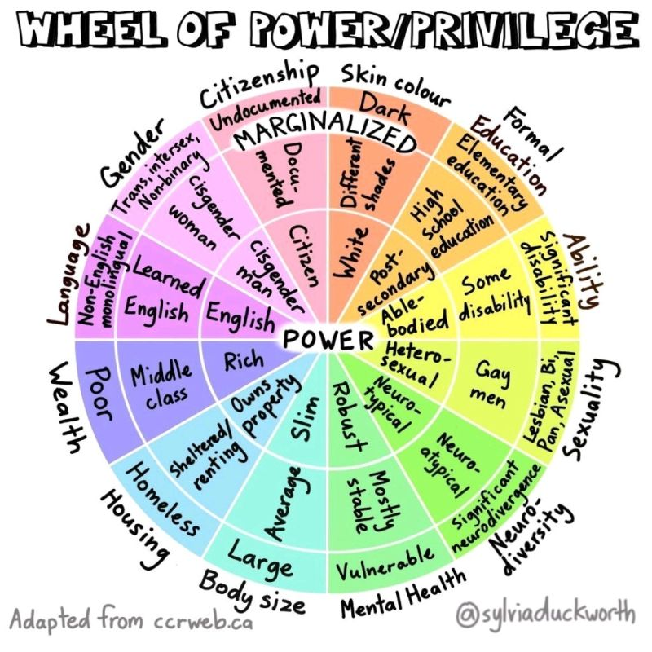

Slide 6
FROM S.M.A.R.T.
TO S.M.A.R.T.I.E. GOALS
Notes:
Your goals should include the voices of those most directly impacted by your work, in a way that gives them agency and influence. For example, when I was able to give large gifts due to the windfall of the home sale, I looked for organizations that were run by POC as well as serving POC. I considered the percentage of Board members who looked like the people the organization served, and I considered how the organization treated their clients and primary change agents in reaching the organization’s mission.

Slide 7
STRATEGIC | Reflects an important dimension of what your organization seeks to accomplish (programmatic or capacity-building priorities).
MEASURABLE | Includes standards by which reasonable people can agree on whether the goal has been met (by numbers or defined qualities).
AMBITIOUS | Challenging enough that achievement would mean significant progress—a “stretch” for the organization.
REALISTIC | Not so challenging as to indicate lack of thought about resources, capacity, or execution; possible to track and worth the time and energy to do so.
TIME-BOUND | Includes a clear deadline.
INCLUSIVE | Brings traditionally marginalized people—particularly those most impacted—into processes, activities, and decision/policy-making in a way that shares power.
EQUITABLE | Seeks to address systemic injustice, inequity, or oppression.
https://www.managementcenter.org/resources/smartie-goals-worksheet/

Slide 8
SMART | SMARTIE
Build a volunteer team of 100 door-to-door canvassers by May… | …with at least 10 people of color recruited as volunteer leaders first, so that they can help shape the way we run the canvasses.
https://www.managementcenter.org/resources/smartie-goals-worksheet/

Slide 9
ENGAGE YOUR DONORS AND VOLUNTEERS IN EVALUATING YOUR SMARTIE GOALS
“LITMUS” TEST:
Will achieving this goal represent significant progress towards our mission?
Does this goal or its tactics mitigate potential inequities in the outcomes and/or process? Does it advance equity and inclusion in the outcomes and/or process?
Did I get input from people who will be impacted by the process or the outcomes? If not, who do I still need to consult with?
Are the measures of success for this goal clear?
Is there a deadline for this goal?
Do we currently (or plan to) have the capacity, systems, and processes needed to achieve this goal?
(For individual goals) Can I connect each of my goals to an organizational or team goal?

Slide 10
Community-Centric Fundraising is a movement to evolve how fundraising is done in the nonprofit sector…to re-examine every fundraising philosophy and practice they have been taught, engage in vigorous ongoing conversations, and explore doing fundraising in ways that reduce harm and further social justice. Below are examples of things…to [help] plan when [Immediately, Soon, Eventually, or Never) and how [practical next steps] you’ll start applying these strategies.
https://communitycentricfundraising.org/wp-content/uploads/2020/07/CCF_Aligned_Actions_List.pdf

Slide 11
1. Ground your fundraising in race, equity, and social justice
WHAT | WHEN | WHO | HOW
Get your development team enrolled in trainings on undoing racism, especially anti-black racism.
Invite donors, board members, and volunteers to these same trainings and conversations.
Find out which Indigenous Nation(s) your organization and its program spaces are on, and acknowledge it in your fundraising work.
If you are a white-led organization, ensure your budget includes significant funds in your budget for any partner organizations that are led by BIPOC communities before you solicit funds.
Advocate with funders and donors for funding for Black and Indigenous organizations.

Slide 12
2. Invest in BIPOC staff and staff from marginalized communities
WHAT | WHEN | WHO | HOW
If you have development staff of color, increase their professional development budgets.
Encourage and provide time for fundraisers of color to talk to other fundraisers of color outside your organization so they have the support they need.
Audit your salary structure to ensure there is pay parity for staff of color, women, disabled people, etc.

Slide 13
3. Support other nonprofits
WHAT | WHEN | WHO | HOW
Regularly highlight partner nonprofits’ work in your communications (with their permission).
Introduce other nonprofits to your existing donors.
Volunteer at other nonprofits’ events, with their permissions.
Pass along funding opportunities that might be helpful to other orgs.
Don’t apply to certain grants if other organizations are better fits. Encourage the funder to fund these organizations instead.
Decline funding if your organization can afford to; recommend another organization that might be struggling to get that fund.

Slide 14
3. Support other nonprofits (cont.)
WHAT | WHEN | WHO | HOW
Think about having joint funding campaigns.
Give credit to other organizations in your annual reports, grant reports, & at event.
Share your templates, ideas, data, etc. with other organizations.
Offer to help other nonprofits write grant proposals, theories of change, logic model, or whatever they might need.
When appropriate, such as on one-day giving days, encourage the people on your mailing list to give to your partner organizations.

Slide 15
4. Recognize donors of time and talent, not just donors of cash
WHAT | WHEN | WHO | HOW
Send volunteers handwritten thank-you notes and other forms of appreciation.
Send clients handwritten thank-you notes and other forms of appreciation for their participation in helping you raise money.
Provide compensation to people from marginalized communities who help you fundraise by sharing their stories or in other ways.
Stop listing donors by donation levels. If you must list them at all, list by alphabetical order and omit the giving levels.

Slide 16
5. Audit for poverty tourism
WHAT | WHEN | WHO | HOW
Go through your website, social media, and other forms of communication and reflect on whether your org may be perpetuating stereotypes, especially if your organization is mostly white.
Think carefully before asking people to share their personal stories to a room full of white donors and maybe stop doing that.
Reconsider how you do tours of programs so program participants don’t feel like they’re being gawked at.
In your communications, include how donors benefit also, to avoid the “charity, pity toward others” mentality.

Slide 17
6. Ensure your communications and events are accessible
WHAT | WHEN | WHO | HOW
Make sure all your fundraising and other videos are captioned.
Put image descriptions/alt-text on all your images.
Have fonts big enough and with contrasting backgrounds.
If you have podcast or videos, make sure there are also complete transcripts.
Have live captioning at your events

Slide 18
7. Have challenging conversations with donors
WHAT | WHEN | WHO | HOW
Provide opportunities for donors to be engaged with discussion on taxes, colonization, slavery, reparation, wealth inequity, etc.
Encourage donors to think about where their families’ wealth came from.
Identify donors who have said racist, sexist, ableist, xenophobic, LGBTQphobic things and find time to give them feedback.
Push back against donors who make ridiculous requests (Be OK with losing some donors).

