Slide 1
Driving Generosity with Responsive Fundraising
Key Tactics for Building More Personal Relationships with Donors and Increasing Team Collaboration

Slide 2
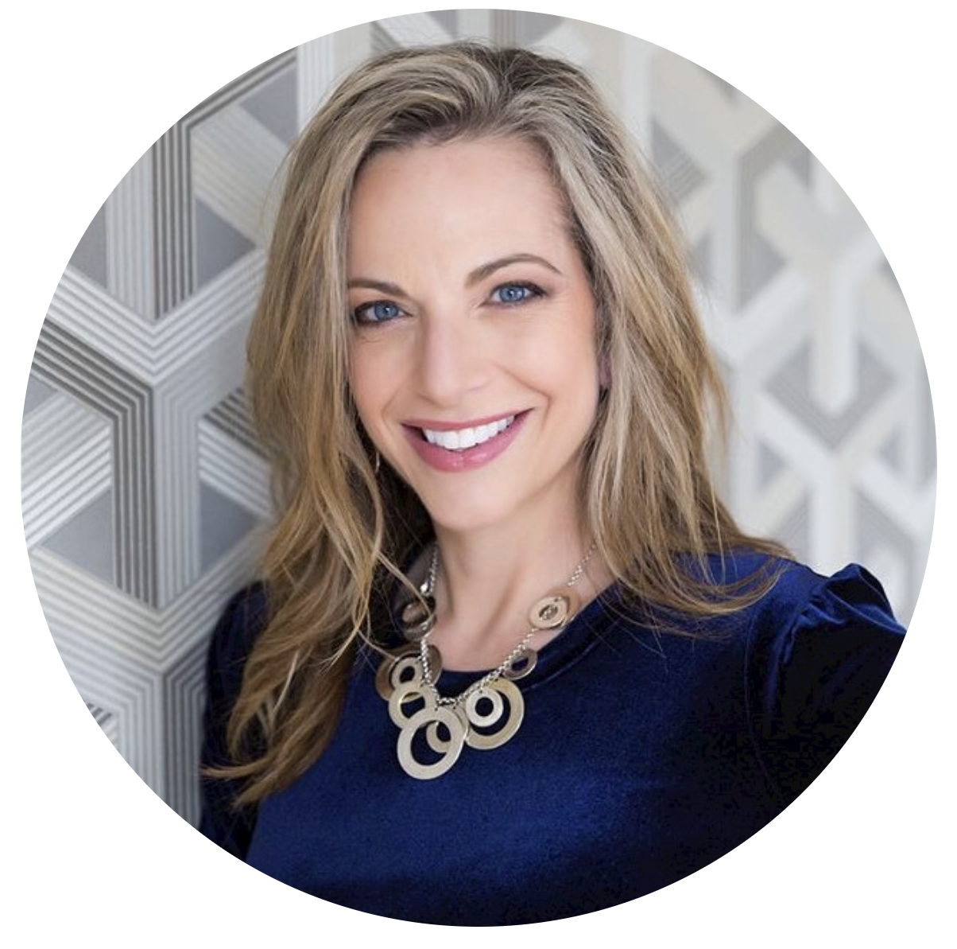
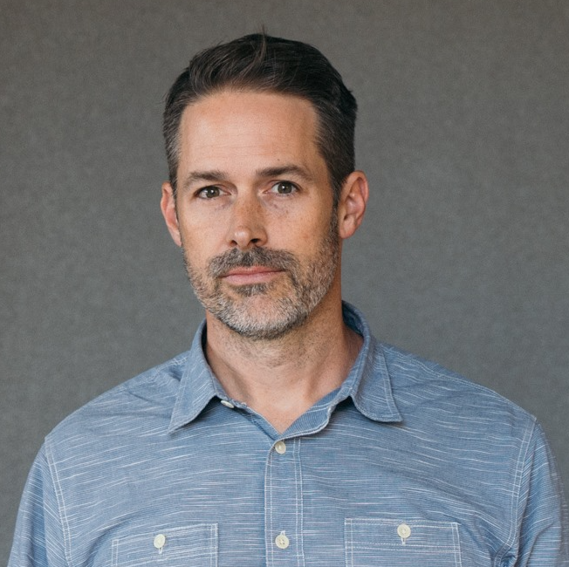
Beth Fisher
Chief Advancement Officer at Mel Trotter Ministries
Gabe Cooper
CEO & Founder at Virtuous Software

Slide 3
What is Responsive?
A fundraising mindset
A team mindset

Slide 4
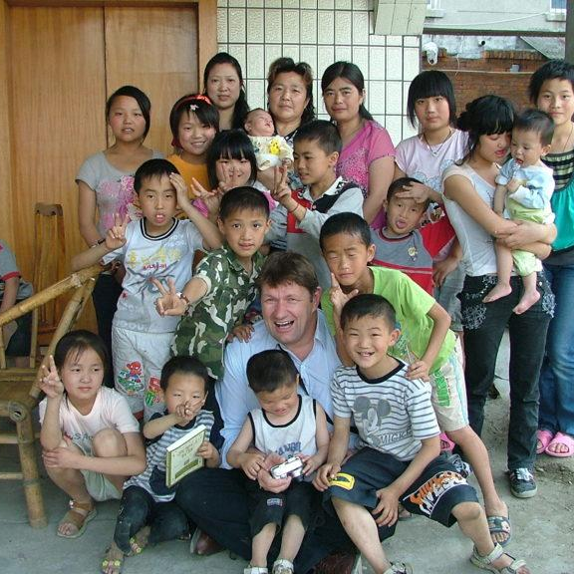
Giving is personal
Today’s donors expect a personal
connection to causes they care about.

Slide 5
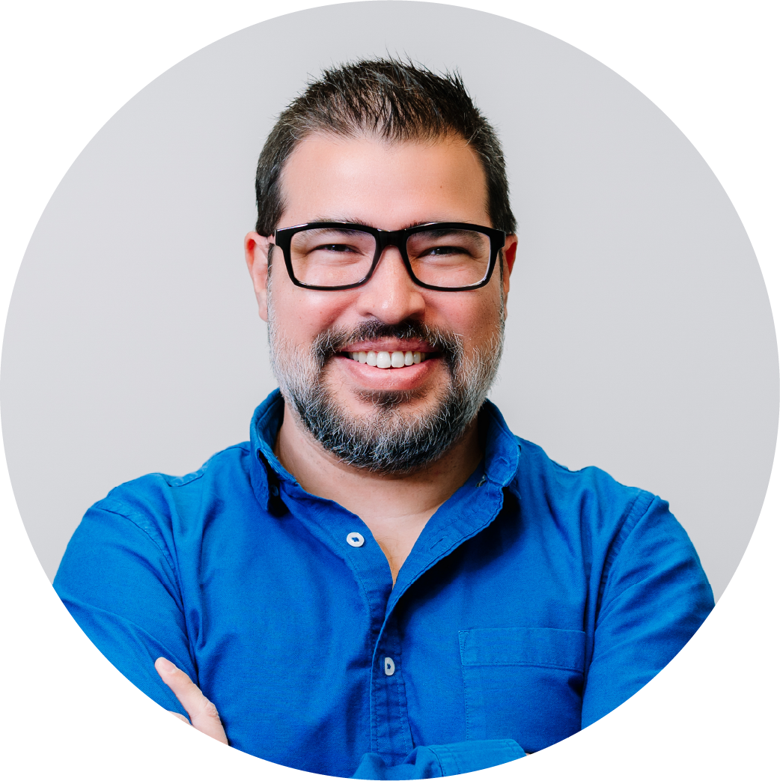
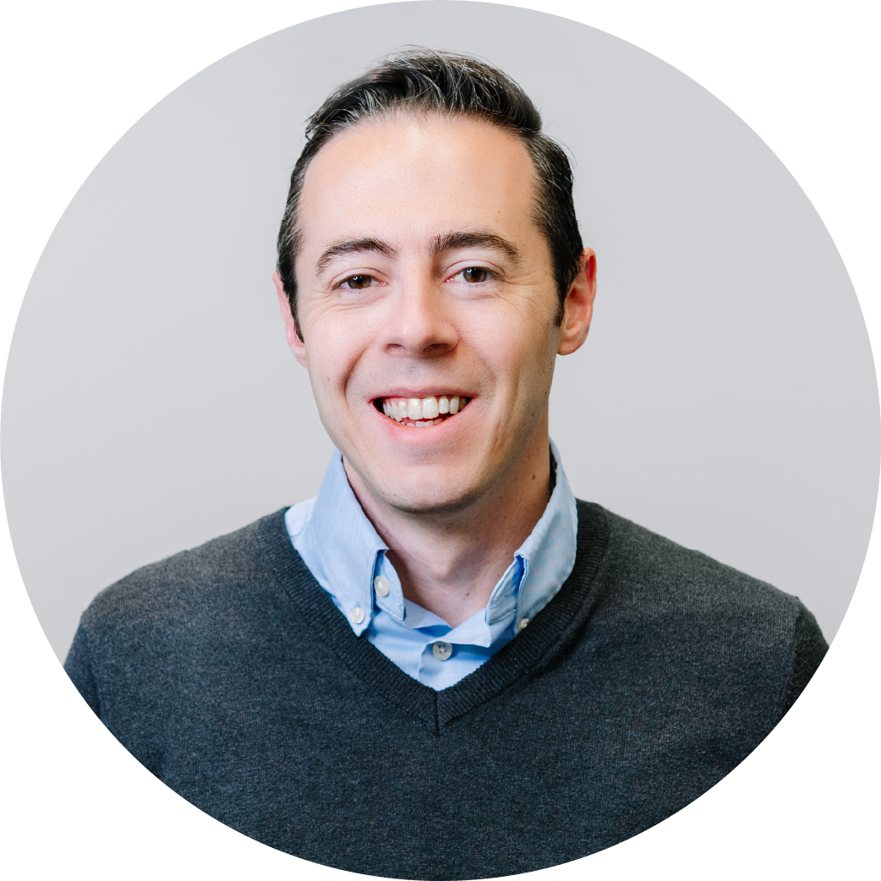
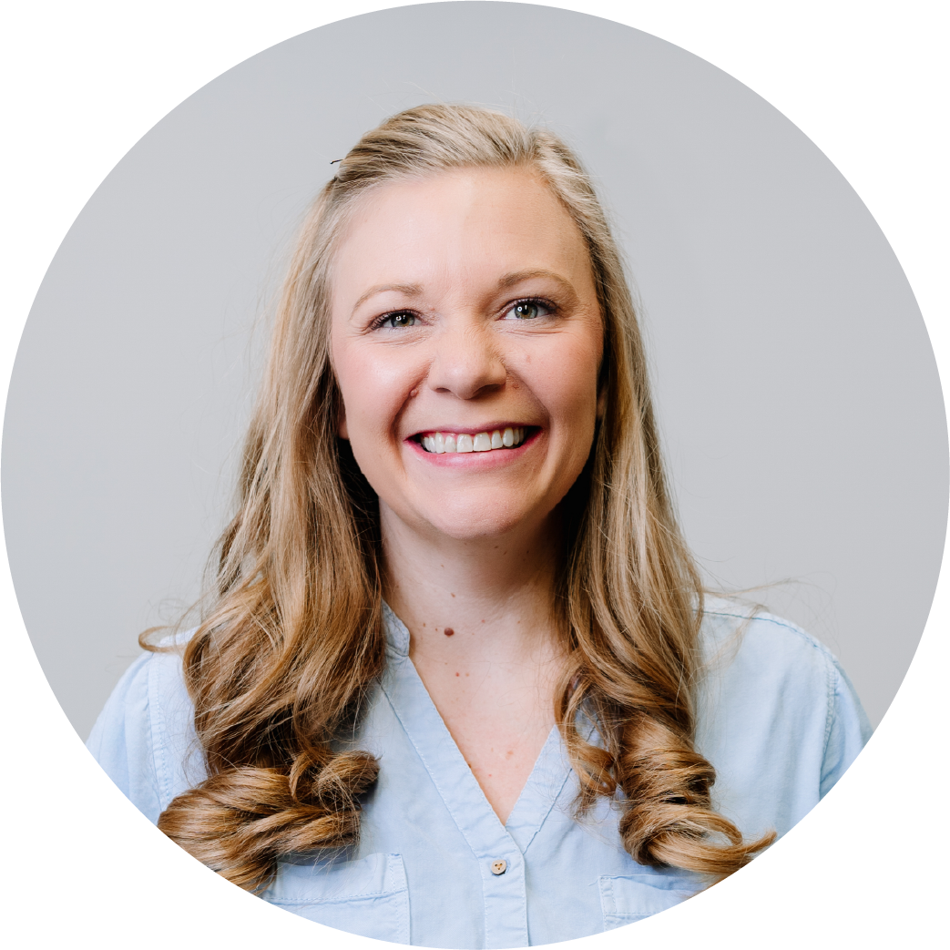
The legacy, impersonal model
Donor/Prospect Acquisition
Retention & Cultivation
Personal and varied Based on donor’s intent
One-to-many (”Spray and Pray”)
One-way based on nonprofit timing. Disconnected from intent
Events
Mail
November
E-Appeal
Year-End
Campaign
January
Newsletter
February
Appeal
76% Attrition
Digital
Friends

Slide 6
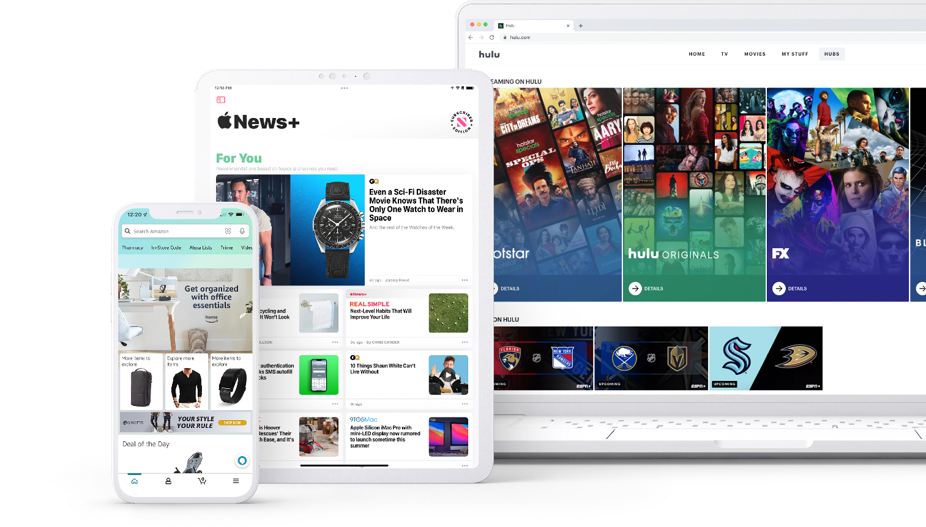
The world you fundraise in has changed.
Personalized experiences
Moving away from one-size-fits-all
Two-way, behavior driven
Triggered in response to data signals

Slide 7
Why donors opt out
50%
Inappropriate asks & impersonal messages
Lacking acknowledgement & transparency
Turn over in donors
every year
Source: Managing Donor Defection by Adrian Sargeant
Notes:
There are two main reasons why donors opt out:
Inappropriate asks and impersonal messages
Lacking acknowledgement and transparency

Slide 8
“Donors not only want to understand the impact of their gifts but value organizations that intentionally foster meaningful relationships with their donors.”
50%
Turn over in donors
every year
Una Osili | Lilly Family School of Philanthropy
Notes:
How do we do this better? At Virtuous we believe in an idea called Responsive Fundraising

Slide 9
02
Listen
Connect
Identify key signals and learn why donors give
Connect personally and automate touches as needed
A better approach
fundraising
Learn
Suggest
Test and validate to become even more responsive.
Suggest next right step with personalized asks.
Notes:
Story of responsive and the four pillars of this approach

Slide 10
Responsive, dynamic campaigns
Donor/Prospect Acquisition
Retention and Cultivation
Personal. Based on Donor Timing
Personal. Based on Donor Timing
Retention
Invited by
a friend
Events
Avg Gift
Story that Resonates
Mail
Fun with Friends
Engagement
P2P

Slide 11
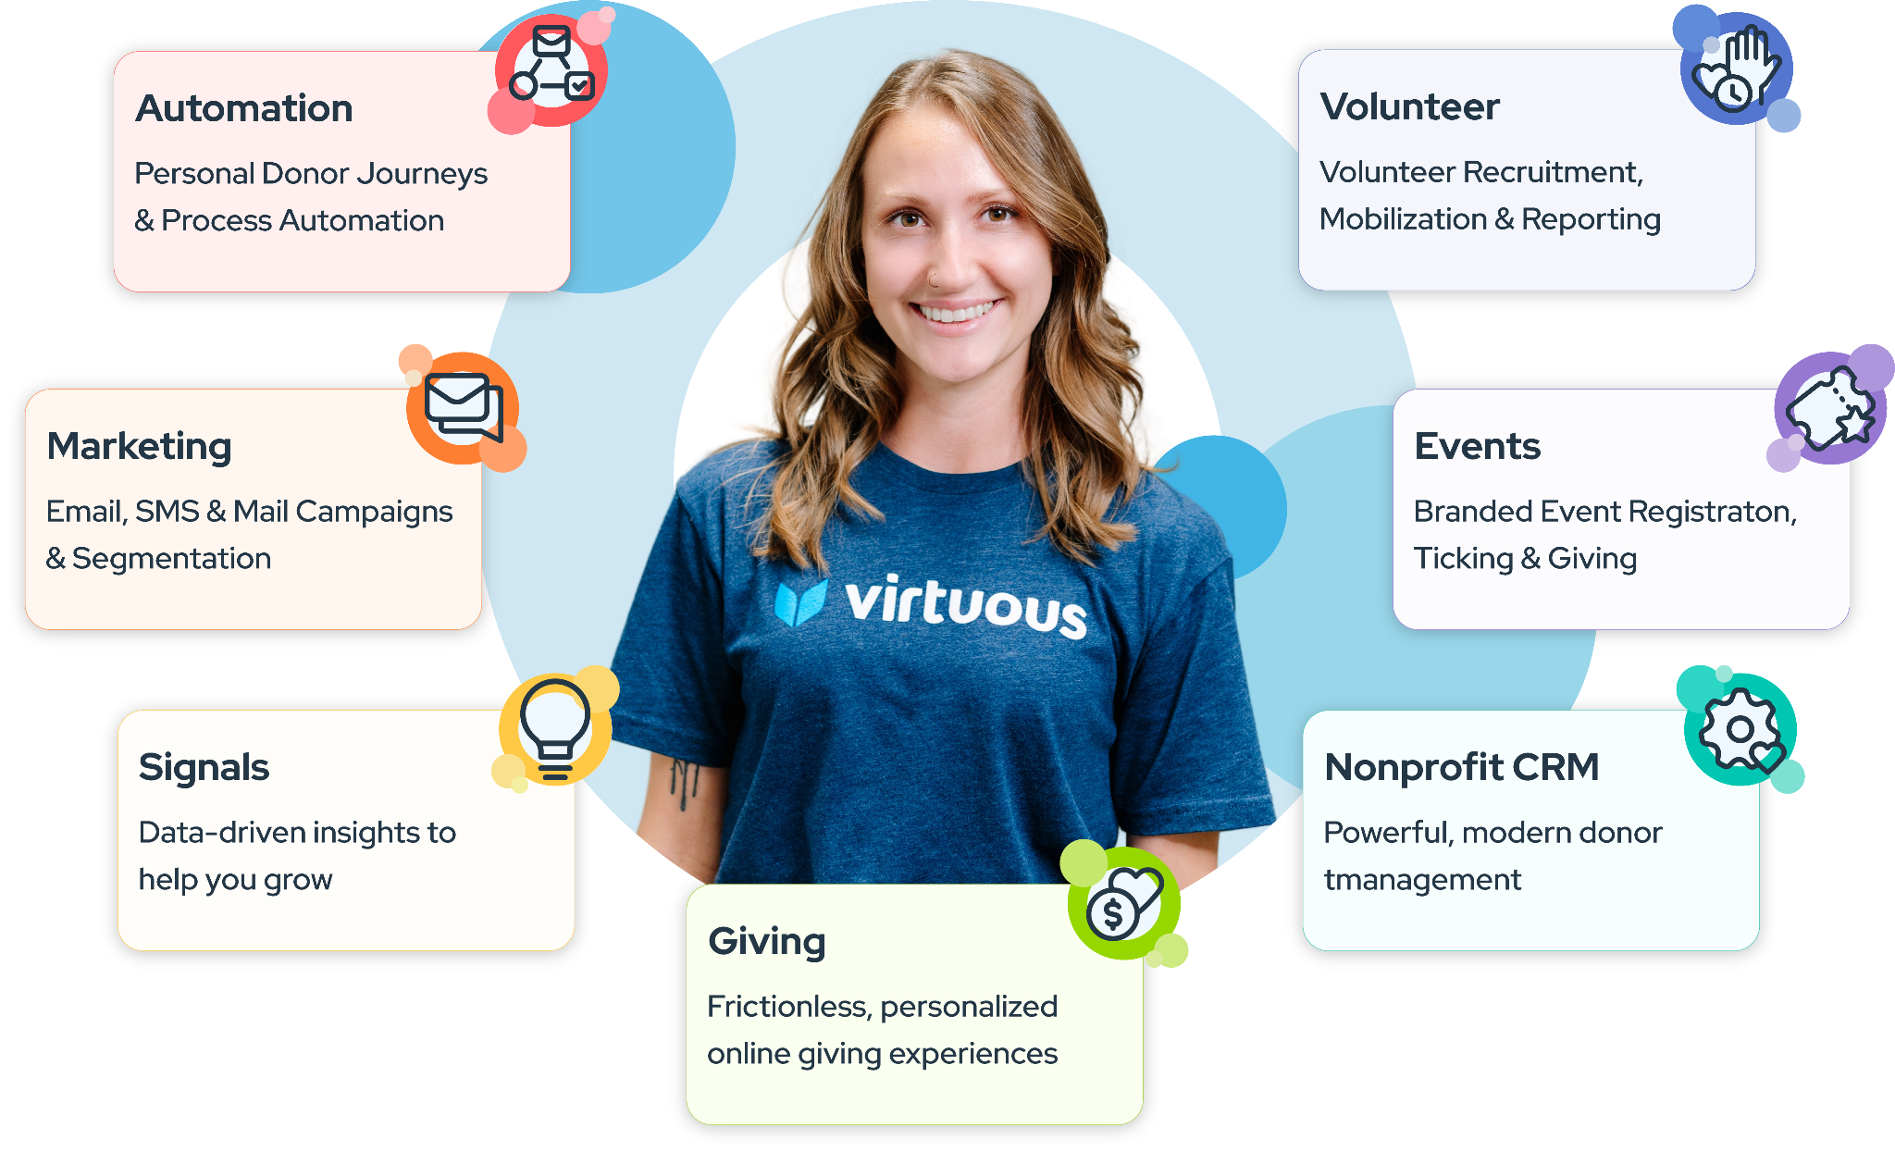
A Responsive Tech Stack

Slide 12
A Response Team
Generosity Operations
Cross-functional owner of data and insights
Connecting learnings from Program, Communications and Fundraising
Focusing the entire organization on shared quarterly metrics
Notes:
There are two main reasons why donors opt out:
Inappropriate asks and impersonal messages
Lacking acknowledgement and transparency

Slide 13
A Responsive Team Mindset

Slide 14
Unsiloing Teams

Slide 15
Unsiloing Teams Org Structure & Communication

Slide 16
Unsiloing Teams The Right Seat on the Bus

Slide 17
Unsiloing Teams Managing Inherited Teams

Slide 18
Accountable to Metrics & Mission

Slide 19
Accountable to Metrics & Mission Data Strategy

Slide 20
Accountable to Metrics & Mission Reporting Transparency

Slide 21
Accountable to Metrics & Mission Growth

Slide 22
Safety in Experimentation/Failure

Slide 23
Safety in Experimentation/Failure Try

Slide 24
Safety in Experimentation/Failure Test

Slide 25
Safety in Experimentation/Failure Transform

Slide 26
How does Responsive look in practice?

