Slide 1
Fundraising Rooted in Racial Justice:
Developing A Gift Acceptance Policy (GAP) That Aligns with Organizational Values
Lejla Bajgorić, Douglas Manigault III, and Regina M. Sharma
Notes:
Monday, April 17 at 8:00 - 9:15 AM

Slide 2
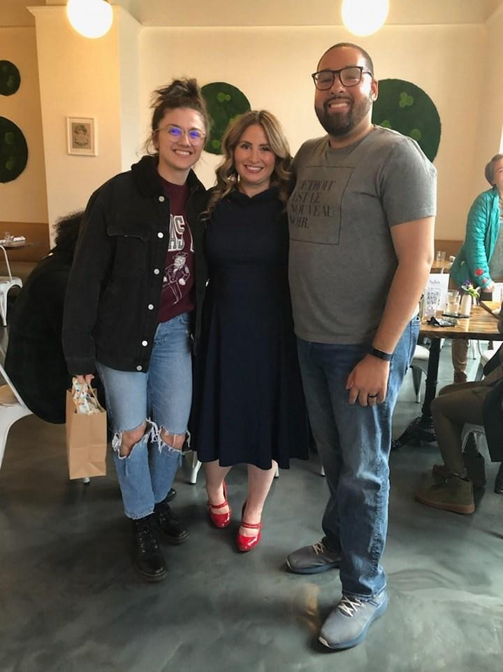
Welcome fundraising colleagues!
About Us
Lejla Bajgorić (she/her)
Associate Director of Development, Detroit Justice Center (DJC)
Douglas Manigault III, MSW, CFRE (he/him)
Chief Development Officer, The Corner Health Center
Regina M. Sharma, MPA (she/her)
Development Director, Detroit Justice Center (DJC)
Notes:
5 minutes
Lejla: Welcome fundraising colleagues! My name is Lejla Bajgorić. I use she/her pronouns and I am the Associate Director of Development at the Detroit Justice Center. My background is primarily in arts & culture and anti-racism social justice spaces in the greater Detroit area. I have a personal passion for the role fundraising can play in mobilizing community and building power for grassroots movements, and I’m excited to be here with you all today.
Douglas: Greetings everyone. I am Douglas Manigault III. I use he/him pronouns and I am the Chief Development Officer at The Corner Health Center. I am also a Lecturer at the University of Michigan School of Social Work, where I teach grant writing and fundraising, program evaluation and applied research, as well as theories of community change. I have spent the last nearly 10 years in fundraising roles that help support several missions, including human services, community mental health, racial justice, and politics / government. The last several years, I have focused on movement-based fundraising, including as a former fundraising professional at the Detroit Justice Center. I am honored to be back with this amazing team to share with y’all today.
Regina: Good Morning everyone. I am Regina Sharma. I use she/her pronouns and I am the founding Director of Development at the Detroit Justice Center. It is such a pleasure to be here in community with all of you today as development colleagues committed to investment in our missions as individual organizations & as a sector. I have always found AFP ICON to be a really enriching experience - not just in our time together in sessions - but also in our time in between - sharing ideas and so I hope that, if not in our short time together today, we have an opportunity to connect at some point this week.

Slide 3
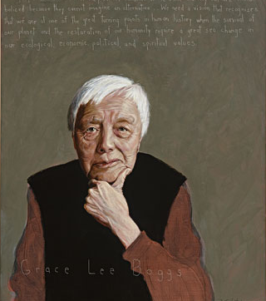
“I feel sorry for people who don’t live in Detroit.”
- Grace Lee Boggs
Image: Robert Shetterly
Notes:
5 minutes cont’d
Regina: A little about me - I’m a very proud Detroiter (as is evident from this biased quote here) and I have been very fortunate to build a career focused on fundraising for organizations that I see as playing a critical role in improving the quality of life for all Detroiters. I began my career about 20 years ago first working in youth and economic development, helping to launch a k-12 ed foundation for the Detroit Public Schools and then I spent about a decade working in higher education and healthcare before joining the Detroit Justice Center two years ago as our founding Development Director.
We are so delighted to share with you all today what we’ve been able to accomplish fundraising in ways that truly aligned with our own values.
And I share this quote from social justice activist, Grace Lee Boggs, because the Detroit Justice Center is rooted in taking our cues from the abolitionist movement, taking our cues from activists and solutionaries like Grace Lee Boggs. What is a solutionary?

Slide 4
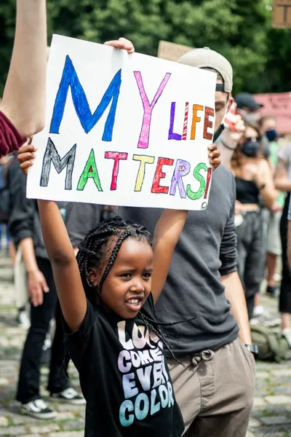
A solutionary is someone who identifies inhumane, unsustainable, and unjust systems and then develops solutions to transform them so that they are restorative, healthy, and equitable for people, animals, and the environment.
Institute for Humane Education
Notes:
1 minute
Lejla: Could someone come read this definition?
Thank you!
We know as a community that Detroit, where we are all joining you from today, is a city of solutionaries (just like the great Detroit social activist Grace Lee Boggs).

Slide 5
Detroit At A Glance
Population:
79.1 % Black
48% child poverty
⚫ 1 in 4 homes subject to tax foreclosure (2011-15)
⚫ 200,000 residents with water shutoff
⚫ 35% of people released from prisons return
Mural: Katie Yamasaki
Notes:
Lejla: We have so much to teach the world about how to live and how to care for each other. For instance, we are decades ahead of the curve in things like urban agriculture. When grocery stores left, people didn't want to leave so they taught themselves how to farm and how to build resilient local food systems.
But now those experiments are under threat because that land is valuable to developers in a way it wasn't before and so urban farmers need legal support to shore up things like community land trusts that will keep that land in people's hands for generations to come.
Every org is built off of a movement and some form of social injustice, and this is the local movement that we are beholden to that informs how we developed a GAP rooted in racial justice and in alignment with that movement.

Slide 6
Overview
✓ Organizational background
Centering exercise
Why a GAP now?
Timeline/research
Review of DJC’s GAP
Group exercise: Case studies
Final thoughts/Q&A
Notes:
1 minute
Douglas: With that understanding of what a solutionary is and our Detroit community, we’d like to provide you with an overview of what we’ll be covering here today. We’ve just given you a little background on the organization we serve because it informs how we developed our gift acceptance policy. We will do a quick centering exercise and then we’ll lead into some background on why developing a gift acceptance policy was really timely for our organization. We’ll discuss our timeline and the intensive research process we undertook before developing our gap. We’ll then transition to walk you through the components of our gift acceptance policy. For our activity, we will walk through three case studies from our work and get your thoughts about how you would respond to potential donors that may or may not align with your organization’s mission and values. Lastly, we’ll close with a Q&A/final thoughts.

Slide 7
Centering us in Community
“Don’t ask what the world needs. Ask what makes you come alive and go do it. Because what the world needs is people who have come alive.”
- Howard Thurman, Author, Theologian, Civil Rights Leader
Notes:
2 minutes
Regina: Now that we have introduced ourselves & talked about our organizations, I just wanted to ground ourselves in this quote, centering us in thinking about our educational endeavors, our careers, our destinations…. as professionals and as citizens of this world….
Could someone volunteer to read this quote?
Great! Thanks so much for reading. So, as we mentioned earlier, we as a team come back to the wisdom of social justice leaders often to ground ourselves in why we do this work, why we chose a career in the nonprofit sector, why we chose to be professional fundraisers and how we show up everyday. And our wish for you as you’re either embarking on your journeys or perhaps you’re mid-career or have been in this work for many years, is that you think about doing the same…thinking about what makes you come alive and building your life around that.

Slide 8
Centering us in Community
Word Cloud Exercise
What are you hoping to receive / takeaway from today?
What are you willing to give to this space today?
What makes you come alive?
Notes:
10 minutes?
Lejla: When we all came to the Detroit Justice Center - it was with the same passion and purpose that Howard Thurman talks about:
How can we be doing the most important work right now with other people who have come alive?
Now that you know a little bit about us and our work, we’d like to hear a little bit about you and unfortunately since we don’t have quite enough time today to go through introductions of everyone in the room. The way we’d like to invite you into this space is through a centering exercise, please share in the cloud, answers to four questions:
Share with us your names, pronouns & where you’re from.
What are you hoping to receive / takeaway from today?
What are you willing to give to this space today?
And then lastly, what makes you come alive?
Douglas: Read aloud audience responses. Add in our own responses if relevant. Thank you all for participating. We will assure that we are being intentional about what you are hoping to receive as we continue in this space in community with all of you. Transition statement to move to our opening….We’re now going to begin with background on why a gap for DJC at this point in time?

Slide 9
Background
Notes:
5 minutes
Regina: Just over two years ago I had my first conversation with the Detroit Justice Center. I had no idea what to expect. The organization was only about 3 years old at the time. This was only about 6 months removed from the racial uprisings in 2020 and an enormous nat’l spotlight had been placed on racial justice organizations. We were the only local organization with a revolving bail fund. We were filing lawsuits on behalf of protestors who’d been arrested during the uprisings. As COVID was raging in the jails, we were fighting to get community members released and back at home with their families. And I was really interested in learning what DJC’s expectations were about launching a development program.
And one of the first things our founding Executive Director, said to me in our conversation was the great need DJC had for developing a gift acceptance policy. And we of course talked about all of the other things you do when you’re hiring a Development Director - building a strong relationship with new & existing donors, building a strong development team, increasing our pipeline, but never had I heard the first sentence to come out of a leader’s mouth be building a gift acceptance policy, but then it became clear to me with her next sentence which is a statement I will never forget: “We will not be owned by the wealthiest families in Metro Detroit like so many other organizations in this community.” And I almost fell out of my chair. I understood exactly what she meant. Philanthropy is complicated. And while we all work everyday to build deep and lasting relationships with significant philanthropists - be it foundations or corporations or individuals - not everyone has attained their wealth in ways that don’t also inflict harm on our communities. And specific to our work at the Detroit Justice Center, we cannot accept funds from entities that in anyway negatively impact the clients we serve in our community.
Douglas: I just want to jump in and say I know that it is often taught, discussed, and even preached that before any fundraising happens at an organization, the organization should have an approved GAP. Over that last nearly 10 years, I have only worked at one organization that had a GAP, it was likely because it was a community mental health organization that was highly compliant; and the GAP was similarly riddled with boilerplate information. That is so important, and we recognized that a GAP that was going to work for us had to be specifically tailored for us. That was our priority.

Slide 10
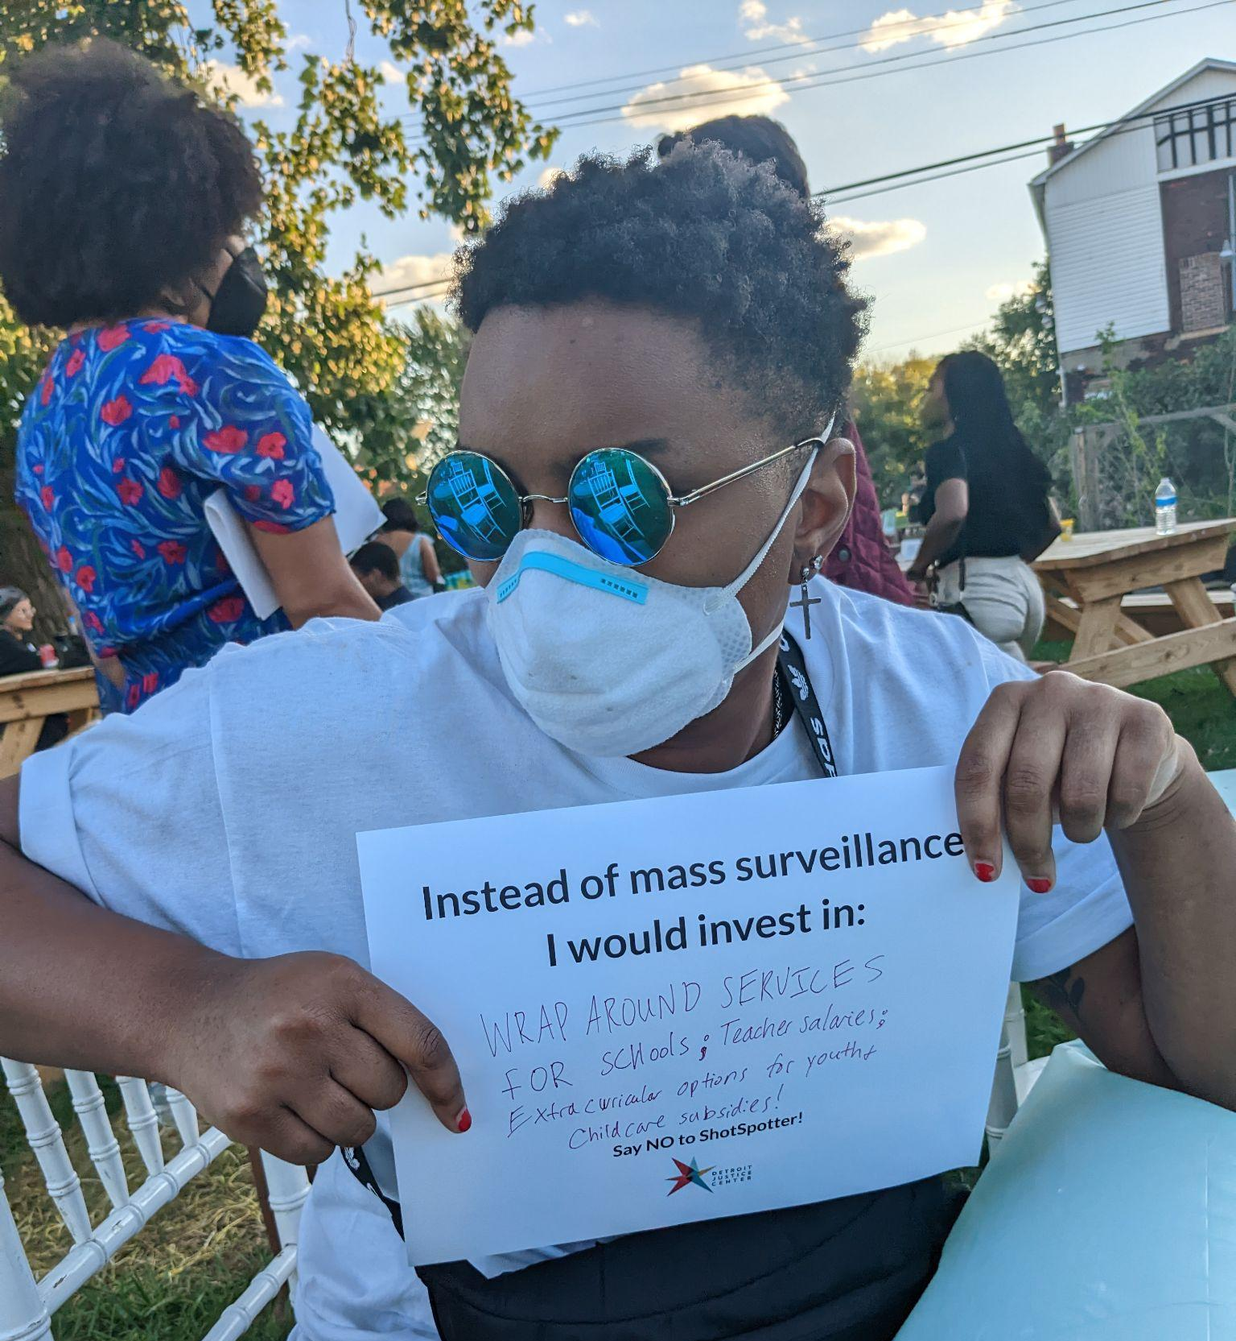
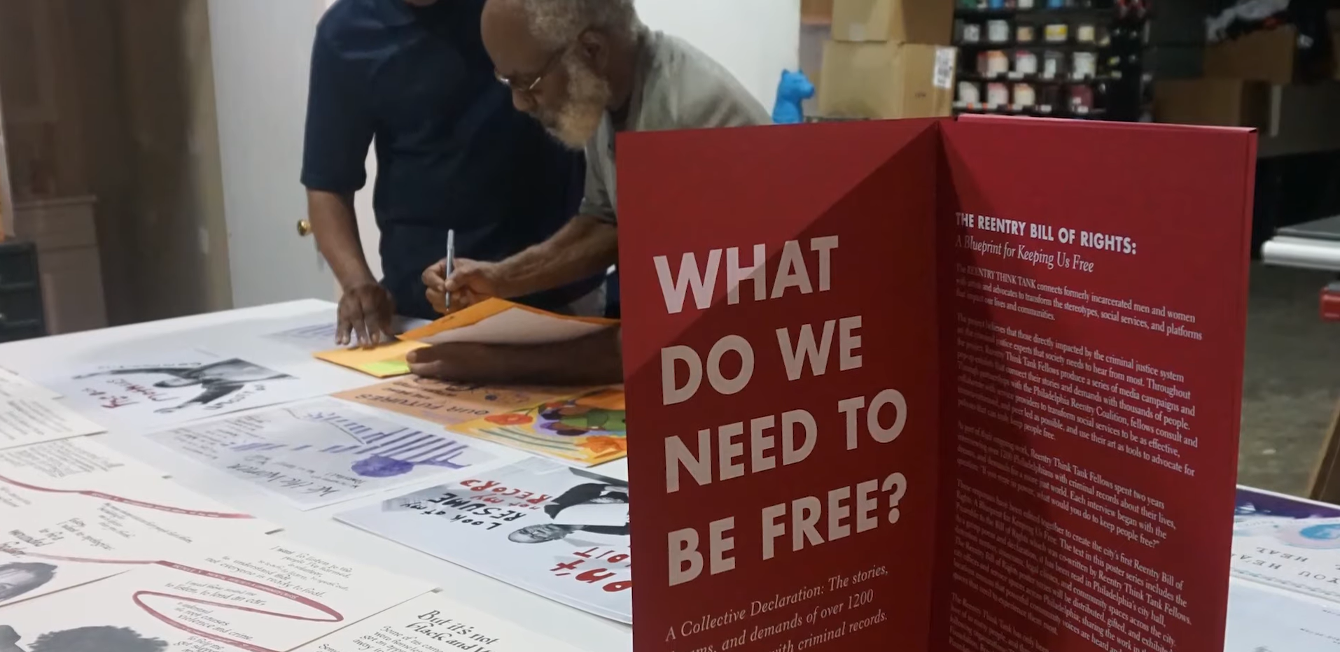
Research
Notes:
Regina: So when our ED told me, Regina, one of your first duties is to help develop a gift acceptance policy rooted in our values, it really was not my most exciting aspect of starting a new position. Because as I’m sure many of you have experienced or can imagine, amidst all of the top things you want to prioritize as a founding Development Director, creating a document outlining instances when you won’t accept funds doesn’t generally fall on the top of that list, right?
In fact, Iike Douglas, I’ve worked for very large institutions in our community who didn’t have gift acceptance policies for this very reason. However, a GAP is so much more than outlining all of the ways you won’t accept funds, it also honors all of the opportunities that you CAN leverage.
So, my negotiation with my new ED, this was spring of 2021 - give me until the end of the year. Because I wanted to get through at least as close to a full funding year as I could before we developed that document so that I could experience all of the different types of scenarios we were presented with before I made a command decision about how to approach this document. The other thing I did not want to do was explicitly write very stringent limitations in our document because though we are at an interesting time in history where funding for racial justice work is being prioritized, we know that funding priorities shift and we don’t want to have made our guidelines so specific that we aren’t able to be flexible and evolve as needed.

Slide 11
Research Process & Sources
Reading / reviewing GAPs
Documenting movement-centered values relevant to your GAP
Understanding social movements
Movement-focused fundraising
Notes:
Douglas: Researching other GAPs, what instances occurred re: funding opportunities, doing all of the homework/information overload/reading all of the GAPs - let’s not lock ourselves out of opportunities, let’s not worry about every single thing that hasn’t happened (a goat, a random piece of art), how do we use movement centered language (we had to find this - it didn’t already exist). We went through hundreds of GAPs and were most inspired by the Jewish Voice for Peace’s GAP
I want to define a social movement for folks who may find it helpful to understand what we mean when we say movement-centered language.

Slide 12
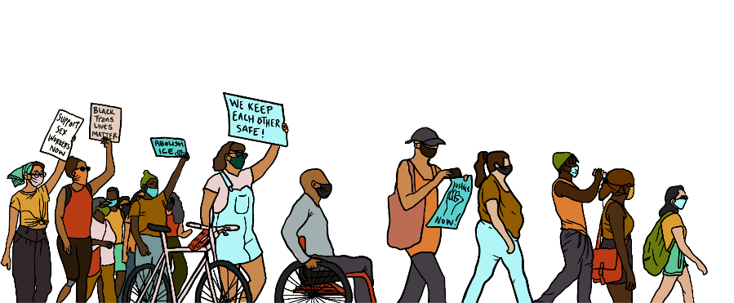
Movement-Focused Fundraising
“A social movement is a network of informal interactions between a plurality of individuals, groups and/or organizations, engaged in a political or cultural conflict, on the basis of a shared collective identity” (Diani, 1992).
Image: Third Wave Fund
Notes:
Douglas: Researching other GAPs, what instances occurred re: funding opportunities, doing all of the homework/information overload/reading all of the GAPs - let’s not lock ourselves out of opportunities, let’s not worry about every single thing that hasn’t happened (a goat, a random piece of art), how do we use movement centered language (we had to find this - it didn’t already exist). We went through hundreds of GAPs and a few that we were most inspired by that we’d like to give credit to include Jewish Voice for Peace, Legal Aid Justice Center and FRIDA.
I want to define a social movement for folks who may find it helpful to understand what we mean when we say movement-centered language.
'A social movement is a network of informal interactions. between a plurality of individuals, groups and/or organizations, engaged in a political or cultural conflict, on the basis of a shared collective identity' (Diani, 1992).
Diani, M. (1992). The Concept of Social Movement. The Sociological Review, 40(1), 1–25. https://doi.org/10.1111/j.1467-954X.1992.tb02943.x
With this definition in mind, movement-focused fundraising centers the movement and its people first and calls the donor into the fold to be a part of the shared collective identity through philanthropy. This is a very similar concept to Community-Centric Fundraising.

Slide 13
Mission & Values
Accountability
Sustainability
& Longterm
Transparency
Notes:
Lejla: At the same time that we were developing our GAP over the course of that first year, we were also defining what our general fundraising philosophy was for our organization’s first development department. As a racial justice and movement led organization, a CCF approach made intuitive sense to us and integrating this approach impacted how we built out our GAP as well.
Some context for folks who may not be familiar with CCF: The CCF movement was born in response to the fact that many traditional fundraising practices center the donor experience (the donor’s feelings, their desires, etc.) instead of the community that our organizations were created to serve, as well as the fact that there’s a general lack of race, class, and power analysis in traditional fundraising. Just as Douglas described fundraising focused on the movement as calling the donor into the fold to be a part of this larger, shared collective identity through the act of philanthropy, CCF too calls the donor in and asks us all to center the needs of the larger community that we’re all part of–we all benefit from a more just world.
How did this philosophy show up in creating our GAP?
Lead with our mission and values as the baseline for accepting gifts–our GAP should be a document that ensures we don’t fundraise in ways that contradict our mission and the values that our organization is working toward
Drawing boundaries and thinking longterm–our GAP needed to provide boundaries for us when it came to accepting contributions from unaligned entities, even if we could use their support in the short term because of the ways accepting their funds could weaken our reputation, and therefore our ability to do our work and our movement overall–which we needed to center
And a third implication is the importance of transparency and accountability to those we serve

Slide 14
Building DJC’s GAP
Mission
The Detroit Justice Center (DJC) is a non-profit law firm working alongside communities to create economic opportunities, transform the justice system, and promote equitable and just cities.
Notes:
Douglas: Fast fwd to Q4 of FY21 and we couldn’t put it off any longer - we finally had to draft this document. So where did we start? We started with the easy part. Grounding ourselves in our mission. Because any good gift acceptance policy should be informed by an organization’s mission and, as Lejla mentioned, it truly is the baseline for determining alignment when it comes to who we will and won’t accept funds from

Slide 15
Building DJC’s GAP
Values
We are committed to individual and collective liberation—and recognize the two as inseparable.
Notes:
Douglas: And then we did the 2nd easiest part, we grounded ourselves in our values and we have a LOT of values. Like our mission, our values inform the type of partners we want in this work. So we’ll share a few examples of how our can values provide that guidance…
Can I have someone read the first value on the slide?
Thank you! – So if you are someone who’s not committed to collective liberation, we may not be the best org to partner with…

Slide 16
Building DJC’s GAP
Values (continued…)
We work with our clients in a way that cultivates dignity and autonomy. We respect and honor each person’s humanity, we seek to understand their stories and circumstances, and we hold their freedom dreams as sacred.
Notes:
Douglas: Can I have someone read the next value?
Thank you! – This one really harkens to the kinds of stories or interactions we’d allow our clients to be part of for the sake of donor engagement

Slide 17
Building DJC’s GAP
Values (continued…)
We value our relationships above all. We work at a pace that allows us to build deep trust with our partners and clients… we communicate with self-awareness, empathy, and humility. Should conflicts arise, we are committed to calling each other in using practices that restore.
Notes:
Douglas:
Can I have someone read the last value we’ve included?
Thank you! – This is another big one because it spells out our vision for wealth and power redistribution. We acknowledge that wealth is historically created in exploitative or oppressive ways, including the wealth of donors. We don’t shy away from that truth and instead invite people in to work toward a world of shared abundance.

Slide 18
Building DJC’s GAP
Values (continued…)
We help clients gain economic independence & work to redistribute power and wealth. We work toward a society in which abundance is shared for the collective good.
Notes:
Douglas:
Can I have someone read the last value we’ve included?
Thank you! – This is another big one because it spells out our vision for wealth and power redistribution. We acknowledge that wealth is historically created in exploitative or oppressive ways, including the wealth of donors. We don’t shy away from that truth and instead invite people in to work toward a world of shared abundance.

Slide 19
Building DJC’s GAP
Our Approach
DJC relies on a broad community of donors to sustain our work. We see the sharing of financial resources as a critical investment in our mission. In addition to financial contributions, our donors share their personal experiences, insights, community relationships and creativity within DJC.
Notes:
Lejla: Building on our mission and values, the next step in creating our GAP was to spell out our approach to our work, specifically our community-centric approach.
The first part reads: *read slide aloud*
This section emphasizes the importance of all kinds of contributions, monetary or otherwise, that are coming from a broad community of donors–not a select few.

Slide 20
Building DJC’s GAP
Our Approach (continued…)
We strive to build strong donor relationships based on clear communication, trust & a shared vision of justice for all.
We take donor privacy seriously and can work with you to ensure that your needs are met. We will not share or sell any donor’s personal information with anyone else or send mailings or email on behalf of other organizations.
Notes:
Lejla: The next section reads: *read aloud*
So aside from assuring the safety of donor data, this part emphasizes our work to bring donors into the fold and, through their philanthropy, volunteering, etc., enable them to see themselves as part of the very community their gifts are supporting. They may not be the direct clients receiving our services, but a world without mass incarceration and racial and economic injustice is healthier for us all

Slide 21
Building DJC’s GAP
Our Approach (continued…)
We know that receiving a donation is a financial but also personal investment from each of our donors, and take seriously the responsibility to put each gift to the maximum possible use.
Notes:
Lejla: Finally, *read aloud*
So, it isn’t just compassion or a sense of pity guiding giving. We all benefit from engaging in the work of social justice. Getting donors to see they and their families personally benefit from their donations – that these are personal investments – is important because it will lead to a stronger investment in their community and our movement.

Slide 22
Building DJC’s GAP
Gift Acceptance Policy
DJC accepts gifts primarily from individuals, foundations and organizations that share a commitment to our values. We reserve the right to decline gifts from individuals or institutions that advocate viewpoints or take actions that fundamentally contradict those values.
Notes:
Regina: And here’s the hardest part - the actual core of the GAP - outlining all of the different types of gifts we will and will not accept
And so I’ve broken this down into multiple slides to break apart how we came to this language……
Regina: so given the example we mentioned earlier, as you might have guessed, corporate gifts tend to be when we most often are posed with potential conflict with our mission and so you can see how we positioned this language here….DJC accepts gifts “primarily” from individuals, foundations & organizations…we reserve the right to decline gifts from individuals that advocate for viewpoints or take actions that fundamentally contradict those values.

Slide 23
Building DJC’s GAP
Gift Acceptance Policy (continued…)
DJC does not generally accept direct corporate donations. However, DJC will consider employee recommended gifts including matching contributions, donor advised funds, employee designations and support from employee sponsored resource and affinity groups. In some specific instances, such as mission-aligned social justice focused funds, DJC may accept or pursue financial contributions or grants from corporations.
Notes:
Regina: And then in our next paragraph we note that DJC does not generally accept corporate donations with the exception of mission-aligned social justice focused funds…however, then, we outline ways that corporations can engage in our work so that we can still provide opportunities for everyone and those include: employee recommended gifts including matching contributions, donor advised funds, employee designations and support from employee sponsored resource and affinity groups

Slide 24
Building DJC’s GAP
Gift Acceptance Policy (continued…)
These considerations are made on a case by case basis with the members of the development team. Considerations above $50,000 are reviewed with and approved by DJC’s Executive Director. Considerations of $250,000 or above are reviewed and approved by DJC’s Executive Director and the DJC Board of Directors.
Notes:
Regina: And then the next section details at what level we engage our executive and board leadership with gift decisions. This is of course going to be a factor that’s very specific to your organization….. for a lot of larger organizations your dollar thresholds would be much higher before considering executive director or board approval and so for this section, it really comes down to - what does a major gift look like for your organization? And secondly, how accessible is your ED or your board in making determinations around accepting gifts?

Slide 25
Building DJC’s GAP
Gift Acceptance Policy (continued…)
This policy may be amended from time to time at the Detroit Justice Center’s discretion.
Notes:
Douglas: And for this final part…this policy may be amended from time to time at DJC’s discretion. So it’s incredibly important to acknowledge for your funders/potential funders that this is a living/breathing document…that your policy will continue to evolve as your organization evolves so don’t get yourself so bogged down with perfection. Think about what your organization needs now and speak to that as you’re building your policy.

Slide 26
Notes:
Douglas: Lastly, here’s a visual from our website–as you can see, you can toggle between each of the sections we went over (our mission; values; approach; and the GAP) within our “Fundraising Approach” section that lives on our website.

Slide 27
Group Exercise: Case Studies!
Banking Institution
2. Professional sports team
3. Recording artist/record producer
Notes:
Lejla: So we wanted to share with you a few examples of some real-life stories that impacted us as we were determining how to shape our own GAP and before we tell you how we approached these opportunities at DJC, we want to hear from you and learn how you would have approached them.
Our first example is a national banking institution with a strong presence in Detroit. As we shared earlier, one of the areas of our practice is economic equity and so we need to be specifically intentional with regard to those entities that have played a role in negatively impacting our clients in some way, in this case through the financial crisis when many of our clients were experiencing the impact of predatory lending and the foreclosure crisis, and so this particular institution was not an entity that we could directly accept funds from.
Douglas:
Another example is one of our local professional sports team who had an interest in making a generous contribution to our work. We learned through additional research that the owner of this team also owns a prison and jail communications company which has an immensely harmful impact on incarcerated individuals & their families having to accept costly calls from their loved ones.
Regina:
Our first two examples were perhaps a bit more obvious in terms of what the negative impact might be on our organization with regard to a partnership, but sometimes even when everything seems very aligned - challenges can emerge and so this is a case where we proceeded with a partnership, but then received some criticism after the fact. So last year we received a very generous donation from a famous recording artist. His late father was a defense attorney in Detroit and he shared that the work DJC is doing would have made his father so proud and bonus - we even had a great personal connection to his father as one of our own attorneys had worked closely with him earlier in her career and had admired him and regarded him as a mentor. The recording artist was planning to hike Mt. Everest later that year as a fundraiser for DJC. Which was great, right? Great social media attention? Great opportunities to leverage his connections. However, occasionally we would get responses on social media that were not so great - one challenging equity issue given the popularity of Mt Everest hikes is the impact it has on sherpas who help guide the Mt. Everest missions and someone actually commented on social media saying “why does DJC need to harm the lives of the sherpas in order to raise money?” Which was a really interesting learning experience for us. This was an impact that we hadn’t anticipated or were planning for.
- professional sports league (not name NFL specifically) NFL (won't accept direct funds - NFL's more recent history with regard to racial equity, but they do have an Inspire Change initiative - which is a player-led initiative that does just that (works toward initiating change in the NFL)

Slide 28
Exercise!
Mission Statement / Guiding Values Mapping Exercise
Notes:
Douglas: Everything we have covered over the last 30 minutes is the set up for our activity. So now that you have seen us consider our mission & values in how we developed our gap and you’ve heard our own case studies, we’d like for you to (practice building a GAP rooted in racial justice). We have case studies on post-it boards around the room and we would like for you to work in your groups to build out a half-page GAP. leave here with a draft of your next steps in building (or refining your GAP).
First consider what your common gift types are, and how they align with your mission. This can be a simple yes / no checklist for if each gift type aligns with your organization’s work.
Make a note for any restrictions that should be specified for the types of gifts you accept.
Jot down three things that have happened in the last three years - with the pandemic and the 2020 racial reckoning that has challenged how we engage racial justice in our work - that is important for you to consider in your fundraising.
Go back to your checklist, and determine if you need to consider any changes to your “yes” list, which may include certain parameters you’d like to add to the types of gifts you accept.
Review the Donor Bill of Rights, and confirm that you are accountable to all of the steps there.
Do all of this before going to do research.
Mission Statement mapping exercise - how do your mission statements align/not align with your GAP, what opportunities are there for improvement?
Break into groups who has a GAP and who does not; different exercise for each
***** we should come prepared with a number of case studies for individuals to utilize to inform some GAP considerations****
Case Study will include:
Mission statement
Types of gifts you receive
Average gift size
Values
Donor demographics

Slide 29
Case Study Debrief
Banking Institution
Leveraging employee resource groups
2. Professional sports team
Engaging players directly
3. Recording artist/record producer
Social media impact
Notes:
Lejla: Case Study 1: We recognize that leveraging partnerships provides an opportunity to educate, to inform and to mobilize community members in corporate settings around our work so as opposed to accepting a direct corporate contribution - we worked with the institution’s DEI employee resource group - an entity that was specifically engaged in incorporating DEI learnings and principles into their workplace. We presented to the ERG and were able to accept funds that were employee-drive while still remaining true to our own values.
Douglas: Case Study 2: The way in which we have been able to leverage a partnership was through accepting funds directly from the professional sports players themselves - engaging players who are committed to social justice & change.
Regina: Case Study 3: The way we addressed it was focusing less on the actual activity our donor was engaged in and more so on the legacy of his father’s work and the impact it has had on our community - not a perfect solution - still an equity question. And if someone asked? Would you accept funds from someone climbing Mt Everest again? I don’t know. We’d really have to think intentionally about it

Slide 30
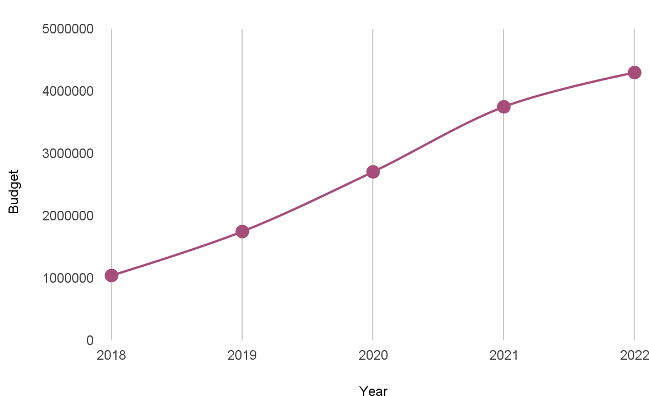
Final Thoughts
Notes:
Amanda’s bold vision and how that allowed us to do what we do…..

Slide 31
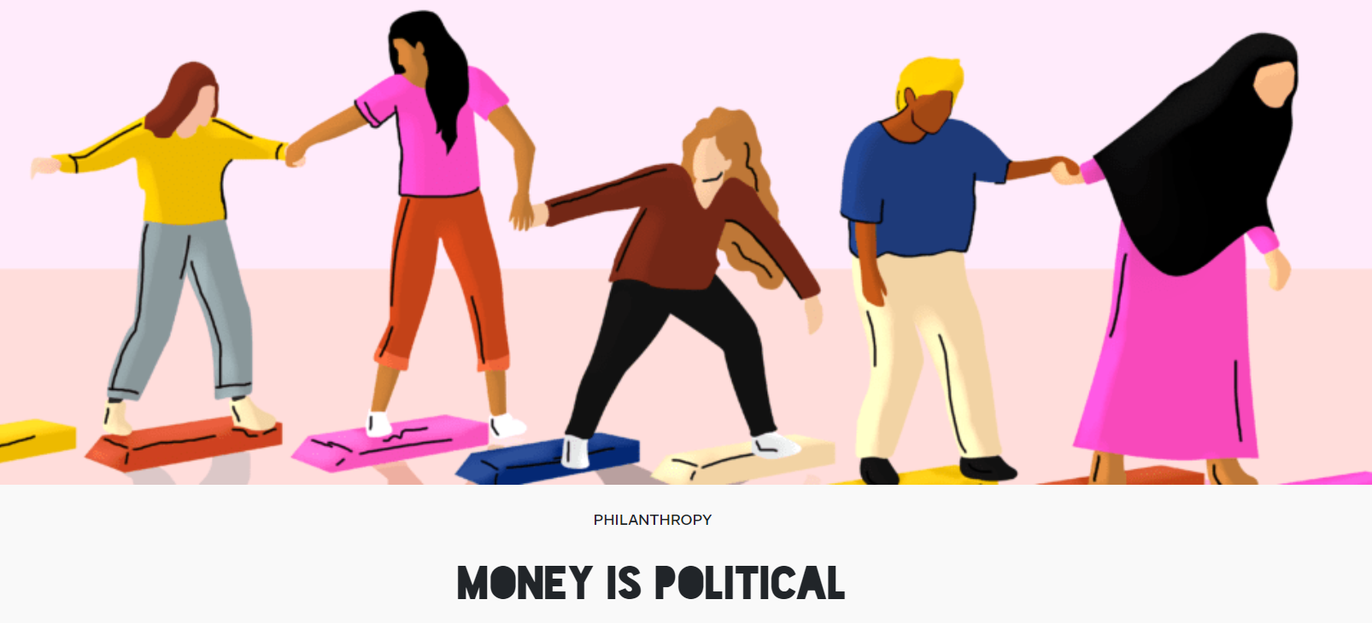
Final Thoughts
Credit: FRIDA
Notes:
Lejla: Thank you all for engaging that exercise with us! We want to leave with some final thoughts before we close and transition to Q&A.
Here’s a case study from FRIDA–a youth-led fund that supports feminist organizing around the globe. They are feminist, explicitly anti-racist and anti-capitalist. Last year, they were approach by Mackenzie Scott, who wanted to make a $10M gift to the organization–the largest individual gift in their history. How did they proceed?
They published an article (Money Is Political) and acknowledged the history behind Scott’s wealth–the “exploitative labor practices that form the basis of the prosperity of billion dollar companies like Amazon.” They also acknowledged that through Scott’s donations, “she has chosen to use her power and privilege towards something meaningful and tangible – particularly through making unrestricted, trust-based donations to organizations that work on issues often invisible to other donors in the sector.”
They ended up accepting the gift, and framing their acceptance as a commitment to “using the funds as part of our larger reparative approach to wealth redistribution, shifting resources back to the hands of our communities, who Amazon and other governments as well as corporations have harmed and stolen from”
We’re closing out with this messy example to emphasize that the answers are not always clear cut, and we will have to continue making the best decisions for our organizations, their longterm financial viability, and the longterm strength of our movements for racial and economic justice. But having a GAP will help us along the way! The folks at FRIDA have a 13-page long one in fact if you’re interested in reading it.
There’s a reason that, even if they’re challenging to make, institutions and movements ranging from the Lily School, CFRE, the CCF movement and the AFP, all encourage and emphasize the importance of having a guiding document–even if it’s one unlike others out there that you have to create for yourself as you chart your own path. We hope we’ve helped provide a reference point for your own journeys and invite you all to stay connected and lean on one another–your fundraising colleagues–along the way.

Slide 32
Developing A Gift Acceptance Policy That Aligns with Organizational Values
Thank you!
Questions & Comments?
Notes:
10 minutes
create a handout to print: Links to where we got our information from, Detroit’s condition and what it means for fundraising here

